Slide 1
Dr. Irene Chen 陳琳琳
Current Trends of in Teaching & Learning
Summer 2013

Slide 2
Mini Me and Dr. Evil from Movie “Austin Powers”

Slide 3
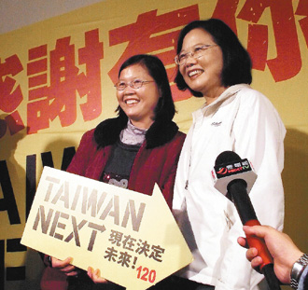
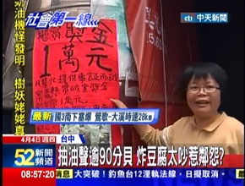

Slide 4
A Few Buzz Words for Teaching & Learning
Diverse Learners
The Youth Culture
Student-centered vs Teacher-centered
Individualized Instruction
Hybrid Learning
Service Learning
Collaborative Project
High Impact Teaching and Learning
Pedagogy of Poverty
Bloom’s taxonomy 分类学
Higher Order Thinking Skills (HOTS)

Slide 5
Diverse Learners
Genders
Ages
SES 社会经济地位
(social economic status)
Ethnicity 种族划分
Races 人种
Disabilities

Slide 6
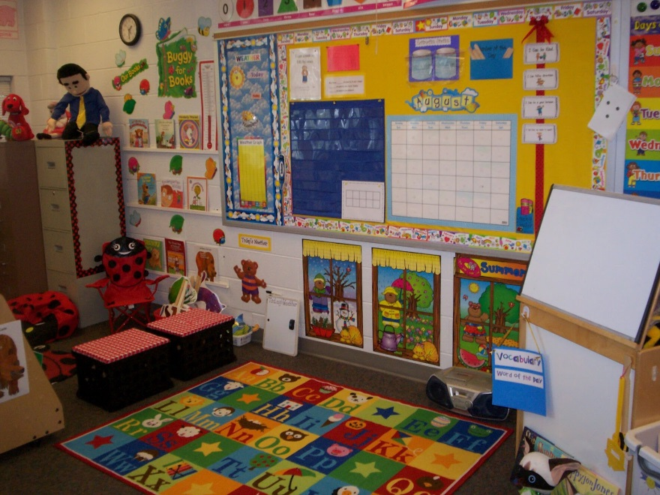
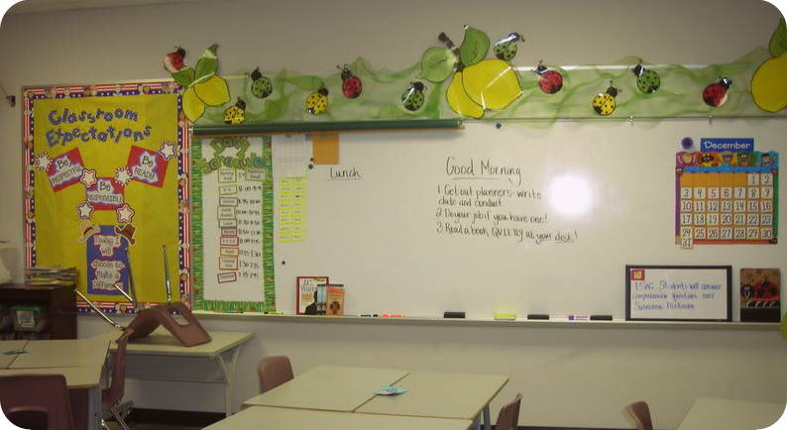
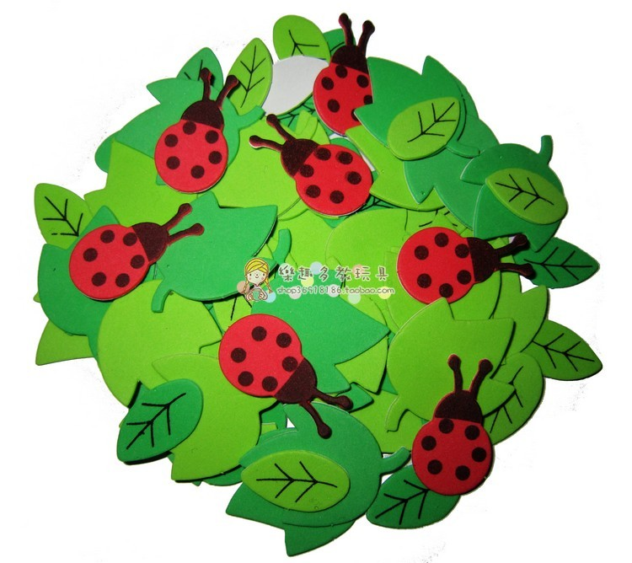
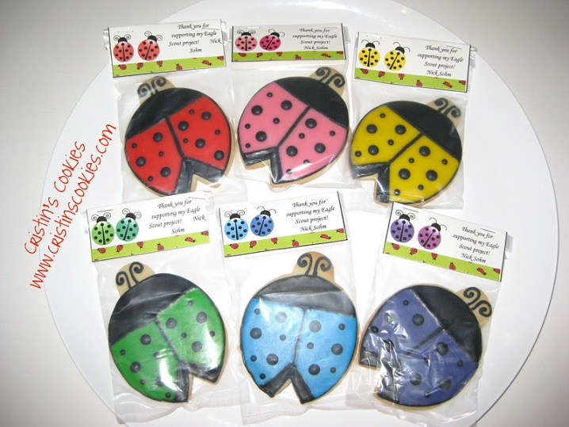

Slide 8
Student-centered
Focusing on the needs of the students, rather than those of teachers and administrators
In contrast to traditional education
Student-centered learning requires students to be active, responsible participants in their own learning.
Teacher-centred learning has the teacher at its center in an active role and students in a passive, receptive role.

Slide 9
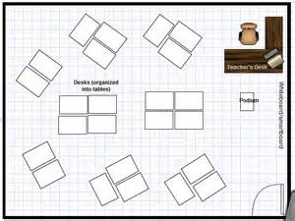
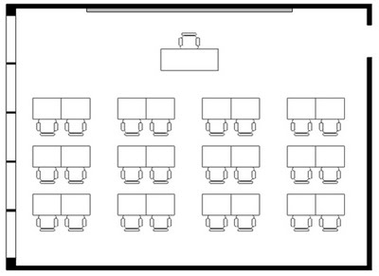
Student-centered vs Teacher-centered
2
3
1

Slide 10
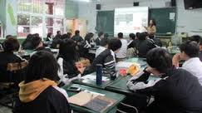
In teacher-directed instruction
Students work to achieve curricular objectives in order to become critical thinkers
Students complete activities designed by the teacher to achieve academic success
Students respond to positive expectations set by the teacher as they progress through activities
Students are given extrinsic motivators like grades and rewards which motivates children to internalize information and objectively demonstrates their understanding of concepts
Student work is evaluated by the teacher

Slide 11
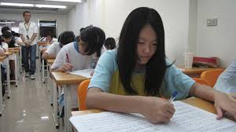
Student-centered
What the child is curious about learning
Teaching strategies to accommodate individual needs
intellectual
emotional
Student's social needs: collaboration, communication, peer approval
Curriculum goals overall

Slide 12
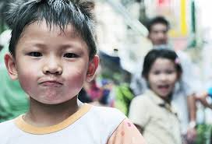
Student-centered
Strengthens student motivation
Promotes peer communication
Reduces disruptive behavior
Builds student-teacher relationships
Promotes discovery/active learning
Responsibility for one’s own learning

Slide 13
Individualized Instruction 个别化教学
Personalizes instruction to the needs and learning style of the learner.
This is done by
varying the pace of instruction
Varying the method of learning employed
varying the content to be learned.

Slide 14
Individualized Instruction 个别化教学
Often this is accomplished
within the context of a larger group
through the use of high-quality instructional materials
through reduced lecture time.
Individualized instruction is not the same as one-to-one instruction; it is simply varying the process to meet the needs of each individual learner in the group.

Slide 15
High Impact Practices in US Universities
First-Year Seminars and Experiences
Common Intellectual Experiences
Learning Communities
Writing-Intensive Courses
Collaborative Assignments and Projects
Undergraduate Research
Diversity/Global Learning
Service Learning, Community-Based Learning
Internships
Capstone Courses and Projects
Student Leadership

Slide 16
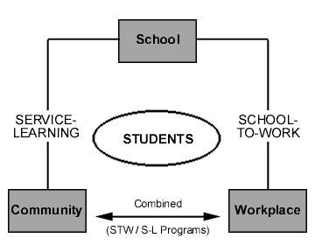
Collaborative Project 合作课题

Slide 17
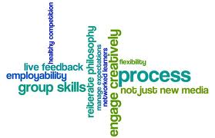
Collaborative Project
In contrast to competition
Jigsaw puzzle
Peer review

Slide 18
Collaborative learning activities
Collaborative writing
Group projects
Joint problem solving
Debates
Study teams

Slide 19
Computer-supported collaborative learning
A relatively new educational paradigm within collaborative learning which uses technology in a learning environment to help mediate and support group interactions in a collaborative learning context
Use technology to control and monitor interactions, to regulate tasks, rules, and roles, and to mediate the acquisition of new knowledge.
Wiki books

Slide 20
Service Learning 服务学习
A method of teaching that combines formal instruction with a related service in the community
direct application
Specifically, service learning integrates
instruction
meaningful community service with instruction
reflection to enrich the learning experience,
teach civic responsibility
encourage lifelong civic engagement
strengthen communities for the common good

Slide 21
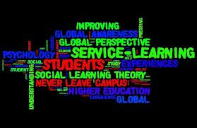
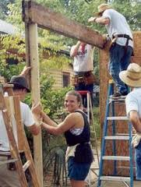
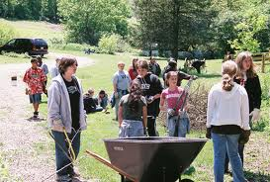
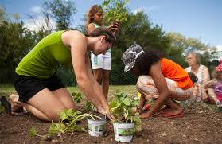
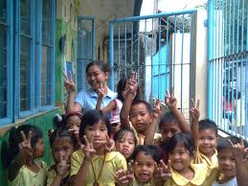

Slide 22
Bloom’s Taxonomy
A model that organizes thinking processes into six levels of complexity: knowledge, comprehension, application, analysis, synthesis, and evaluation

Slide 23
Pedagogy of Poverty
U.S.: Urban, inner-city schools
Taiwan:城鄉差距
The US government's definition of poverty is based on total income received.
Estimates of the percentage of Americans living in poverty range from 12-18%,
Generational poverty
First generation college students
Poverty affects individual access to
quality education.
AERA 2013

Slide 24
Pedagogy of Poverty
Research has found that there is a high risk of educational underachievement for children who are from low-income housing circumstances.
For children with low resources, the risk factors are similar to others such as juvenile delinquency rates, higher levels of teenage pregnancy, and the economic dependency upon their low income parent or parents.
Poor children are much more likely to suffer from hunger, fatigue, irritability, headaches, ear infections, flu, and colds.
These illnesses could potentially restrict a child or student's focus and concentration.

Slide 25
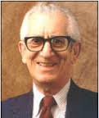
Bloom’s Taxonomy分类学
A classification of learning objectives within education proposed in 1956 by a committee of educators chaired by Benjamin Bloom
班傑明·布魯姆 (Benjamin Bloom) 是美國教育心理學家，突出貢獻是教育目標分類學 (educational objectives) 和掌握學習理論 (mastery learning)。

Slide 26
Three Learning Domains
Cognitive 认知领域
Affective 情感范畴
Psycho-motor 技能领域

Slide 27
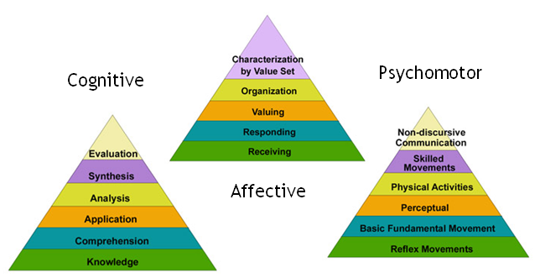
Three Learning Domains

Slide 28
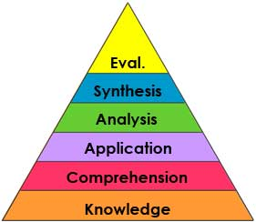
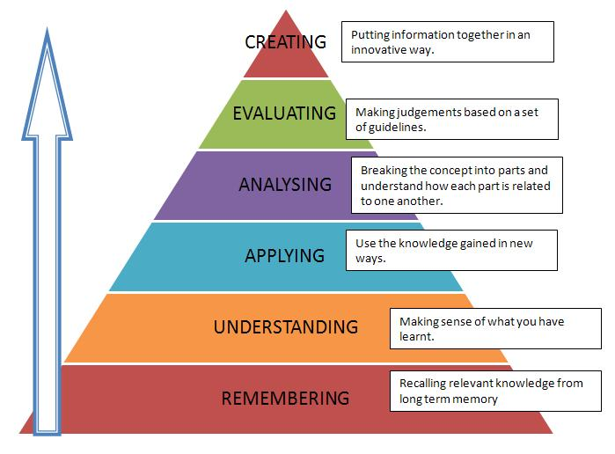
Old Taxonomy and New Taxonomy
Higher Order Thinking Skills (HOTS)

Slide 29
www.trainiac.com

Slide 30
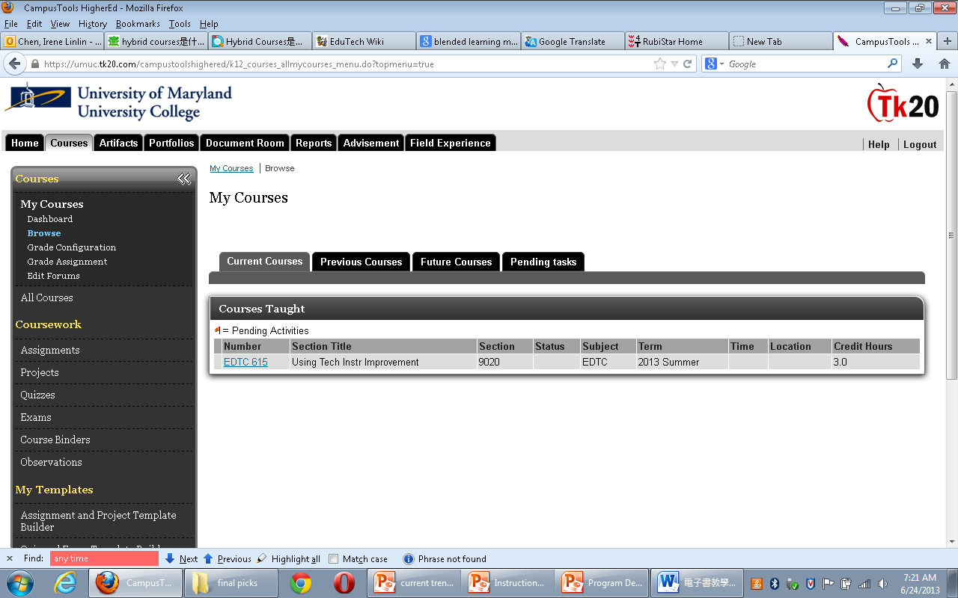
TK20

Slide 31
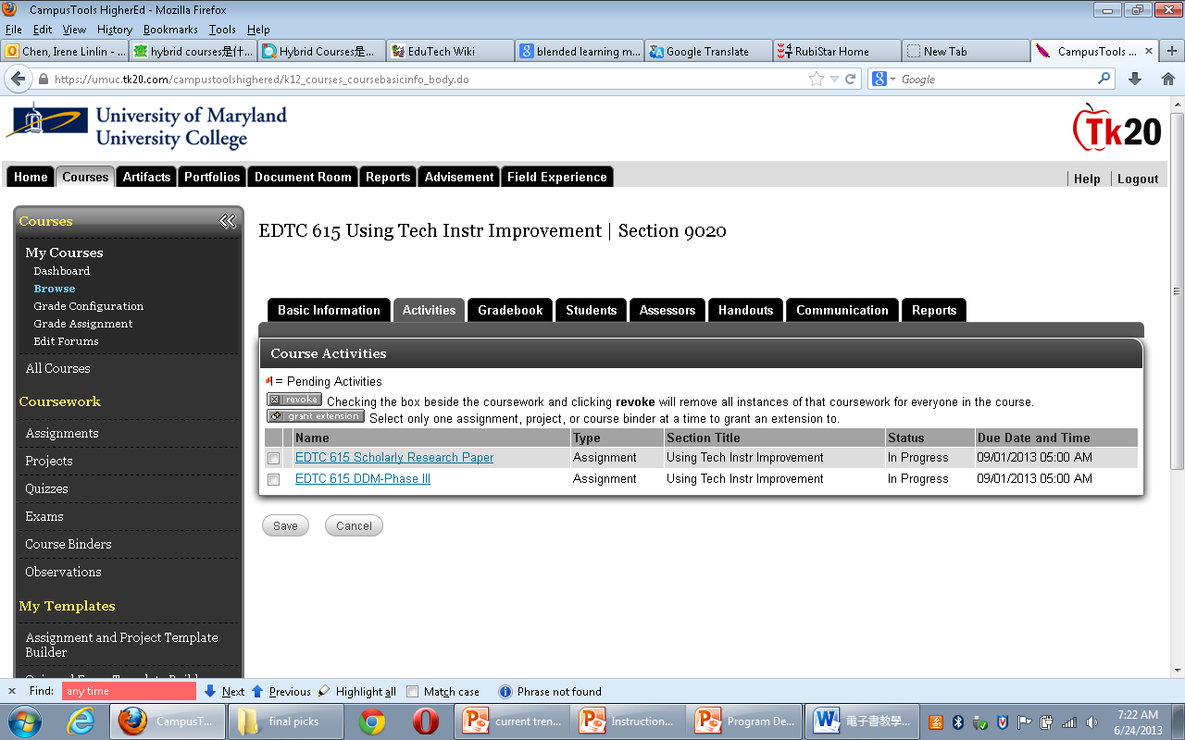
TK20

Slide 32
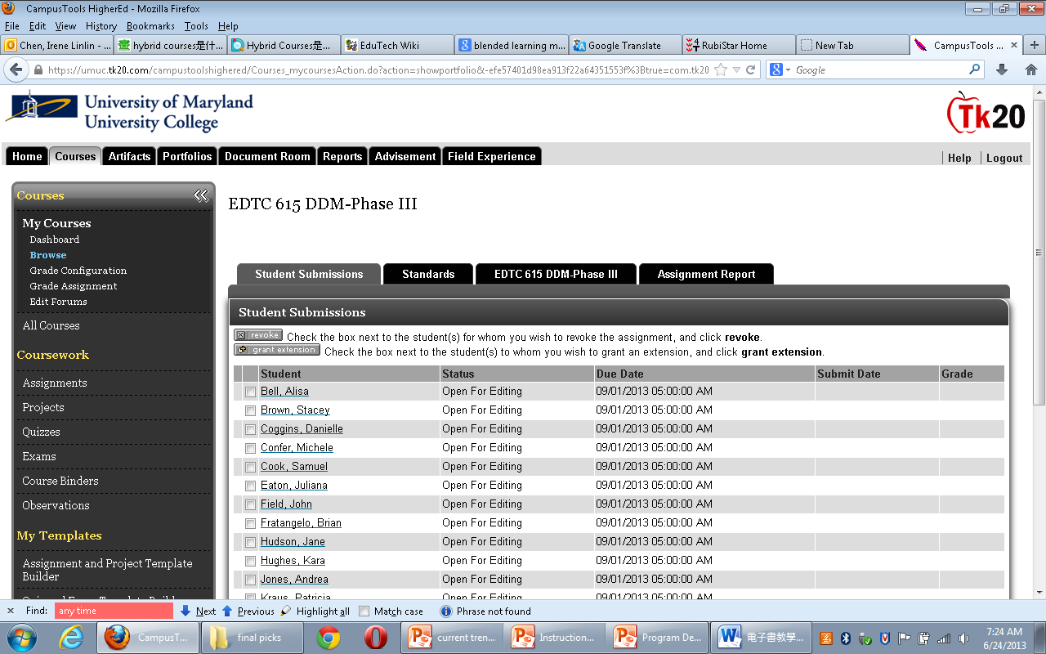
TK20

Slide 33
http://edutechwiki.unige.ch/en/

Slide 34
Q & A
Thank you!
Contact: irenechen14@yahoo.com

