Slide 1
介紹各種形式的電子書 Introducing Various Formats of E-books
Irene Chen
Summer 2013
E-book Workshop at NTHNHS

Slide 2
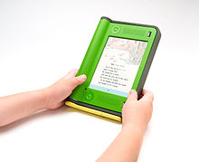
Visualizations of a Book
Google Images

Slide 3
An Electronic Page
A term to encompass the grouping of content between basic breaking points in presentations or documents that originate or remain as visual electronic documents.
A software file
An electronic paper
A hardware display technology

Slide 4
An Electronic Page
Sizes
Standard sized
a word processor file
desktop publishing application file
presentation software file
Dynamic sizes and contents
HTML pages
The number and size of electronic pages in a document
limited by the amount of computer data storage
not limited by the display devices or amount of paper

Slide 5
Two Platforms
Computer-based Presentations
Web-based Presentations

Slide 6
Output 輸出; 出產
Display (screen output)
computer monitor
handheld device
Printing device
Both: PDF and some e-book file format pages are designed to do both

Slide 7
Pages
Screens
Windows
Scenes
Cards
Slides
Other Interfaces

Slide 8
美國出版協會預測
2005年電子書的銷售額占出版業銷售額的6%。
預測2030年出版業將成為電子書的天下，電子書的銷售額將超過90%以上。

Slide 9
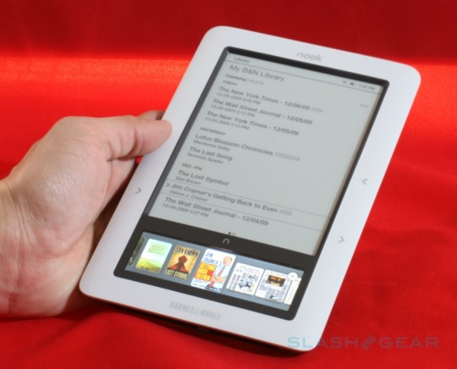
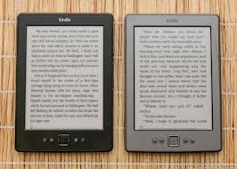
Amazon: Kindle Books Outselling Hardcovers Starting in 2010
Nook from Barnes & Noble Kindles from Amazon

Slide 10
Doctoral Dissertation & Dissertation Project
http://viking.coe.uh.edu/~ichen/ebook/et-it/cover.htm

Slide 11
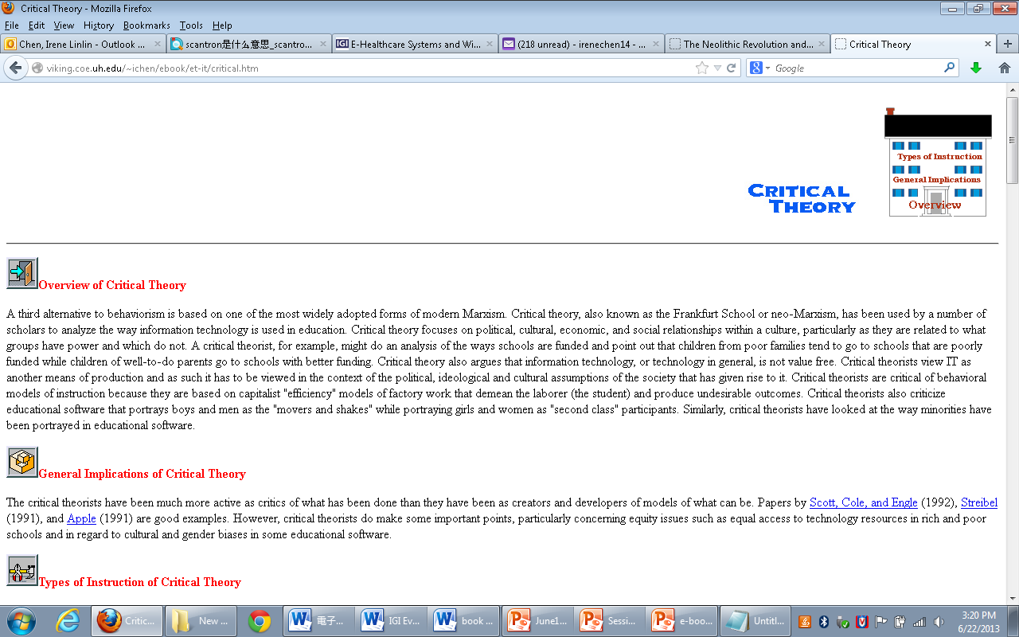
Content page

Slide 12
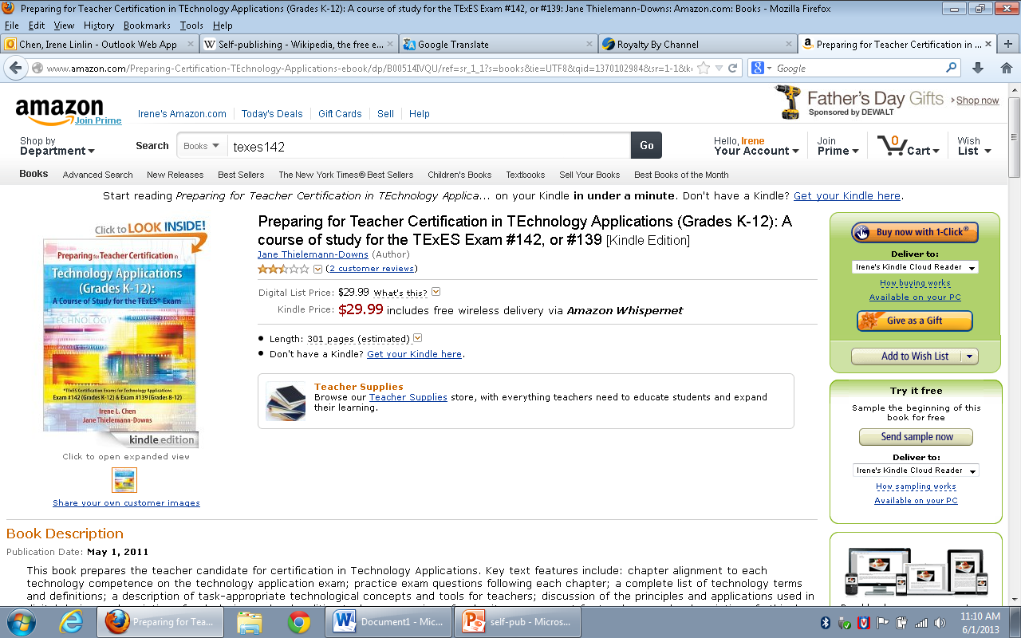
Kindle version sold through Amazon

Slide 13
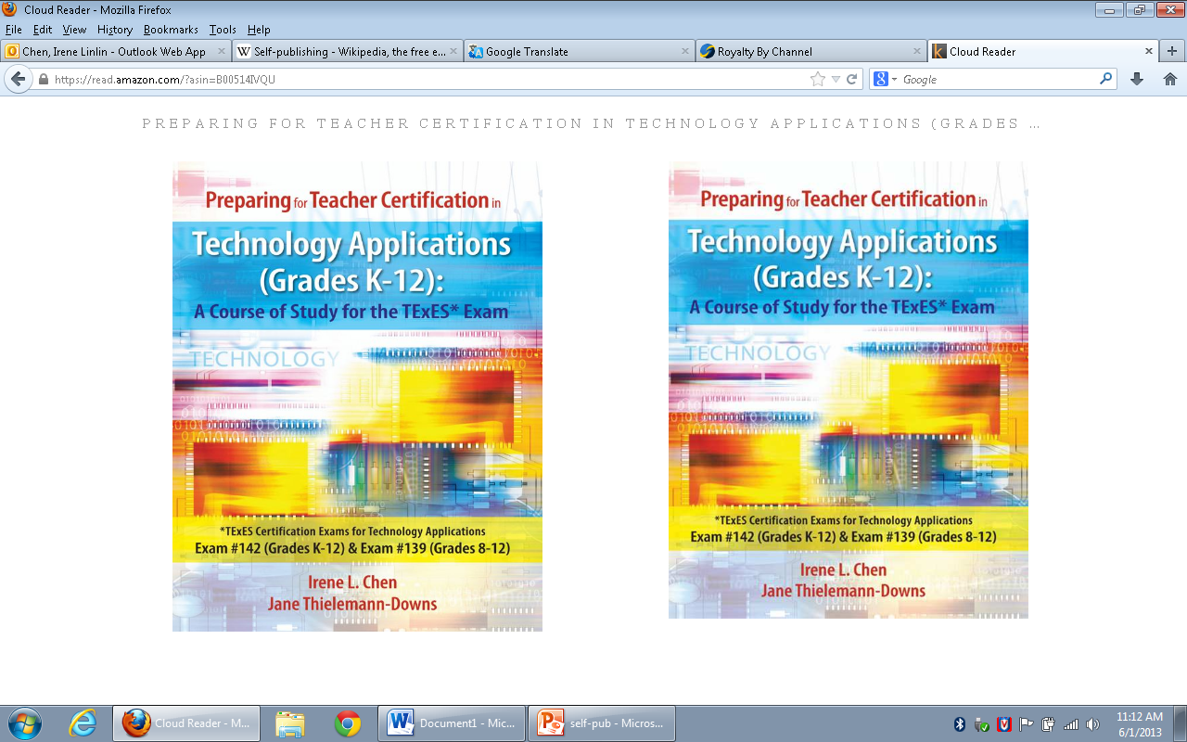
Read through Kindle Cloudreader

Slide 14
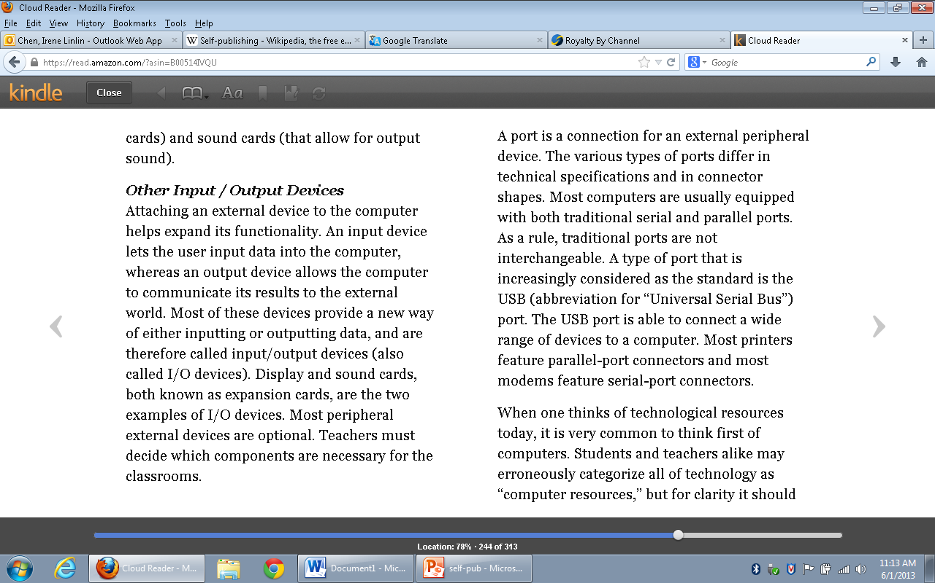
Read through Kindle Cloudreader

Slide 15
Doctoral Student’s Dissertation title: Transforming the Digital Textbook: A Modified Delphi Study
The aim of this study is to identify and define the technical, social, and cultural factors hindering the adoption of electronic textbooks and to identify and create a set of foundational transformational strategies that result in successful adoption outcomes.
The identification of successful strategies will lead to a better understanding of textbooks and their function, resulting in an acceptance of consistent and effective approaches to digital textbook design, utilization, and implementation.
This, in turn, will foster the outcomes needed to fulfill the predicted benefits promised by this revolutionary paradigm changing technology.

Slide 16
Uses of E-books
Textbooks
Books
Journals
Personal diaries & reflections
Comics
Others

Slide 17
Media 媒介
Text
Audio:有聲書
Visual:
Video:
Animations:
Manga漫畫

Slide 18
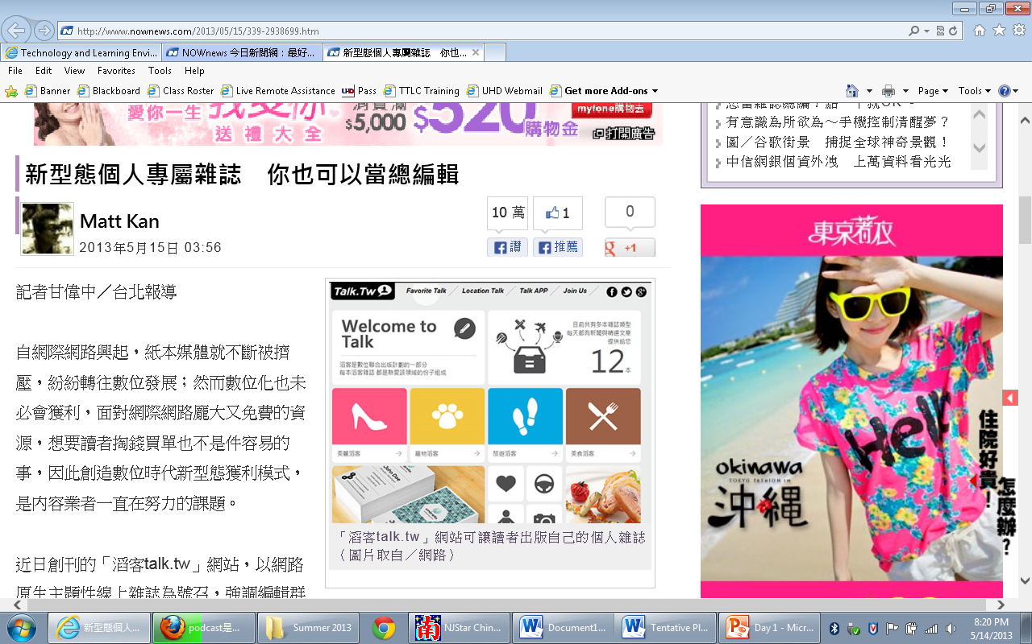

Slide 19
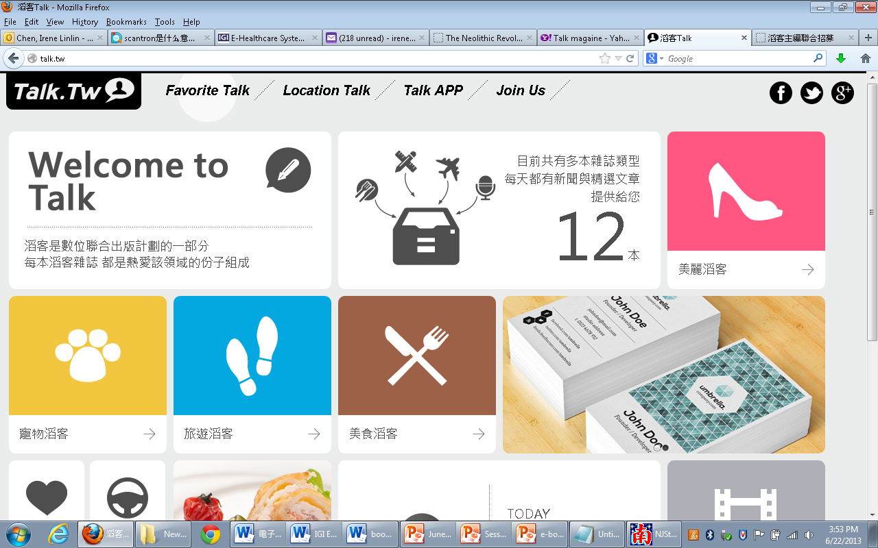
http://talk.tw/濤客

Slide 20
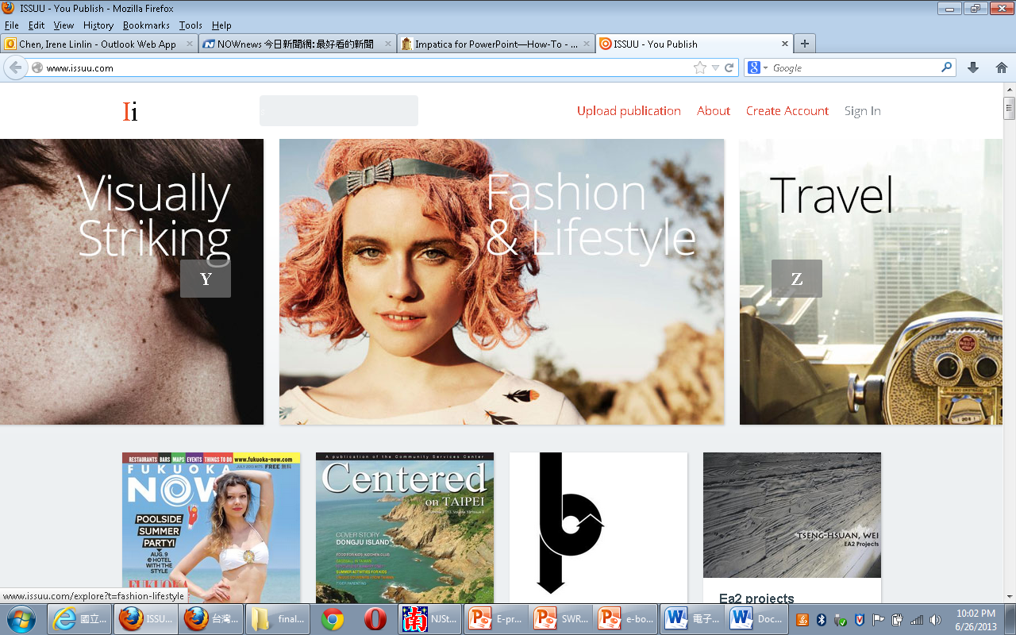
http://www.issuu.com/

Slide 21
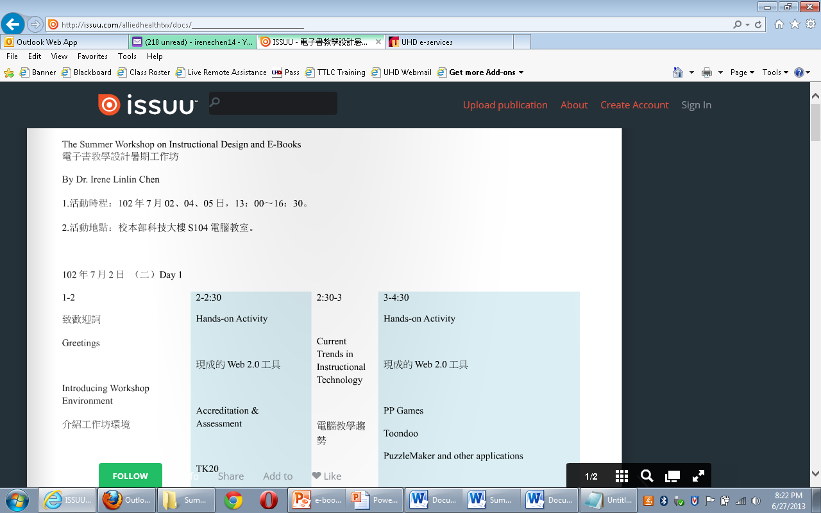
Agenda on ISSUU

Slide 22
電子書優點
製作方便
扱帶方便
價格便宜
更新容易
多媒體形式呈現
可儲存容量大
全文檢索
個人化設定
快速檢索連結功能
很快可以到達讀者手中﹕ 製作，運輸
少砍幾棵樹
對大自然無害
需要多少發行多少，不必先做出具體的產品，只需等待訂戶的訂購，依數量發行

Slide 23
電子書缺點
價錢太貴
操作不易
移動不便
加密技術及版權問題
讀者接受度

Slide 24
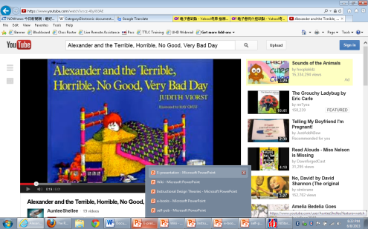
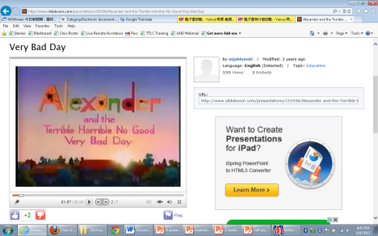
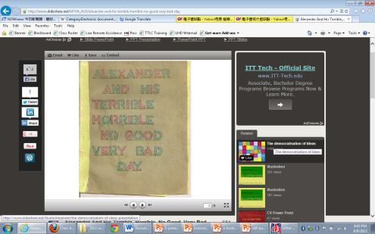
Alexander and the Terrible, Horrible, No Good, Very Bad Day
Printed book
VCR
Youtube
http://www.youtube.com/watch?v=Ezbssw11724
Web Resources
PowerPoint:
http://www.slideboom.com/presentations/152436/Alexander-and-the-Terrible-Horrible-No-Good-Very-Bad-Day

Slide 25
Media Selection
Resier and Gagne's (1983) Media Selection: it is necessary to select a medium for a cluster of similar objectives in the same domain, and attempt to mix compatible media for a various objectives.
The factors in media selections include
The projected availability of various media
The ability of the teacher and the students to manage the media
The ability of the designer or an available expert to produce the materials in a particular media format
Flexibility, durability and convenience of the materials within a specified medium
Cost-effectiveness

Slide 26
Google Images

Slide 27
Kindle Icon

Slide 28
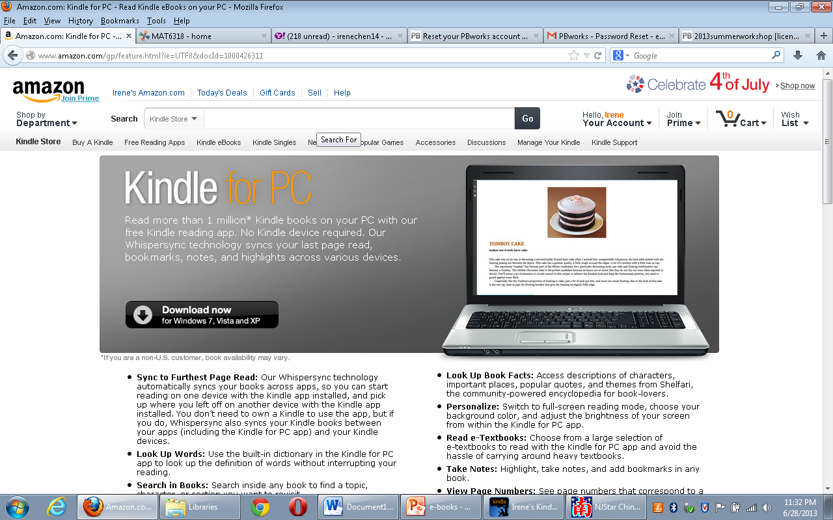

Slide 29
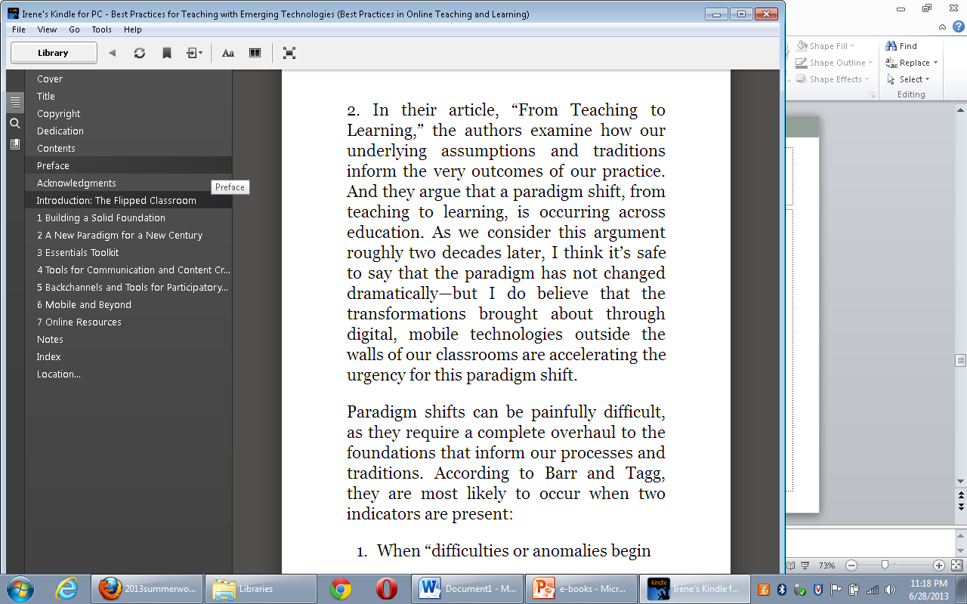
TOC of an E-Book

Slide 30
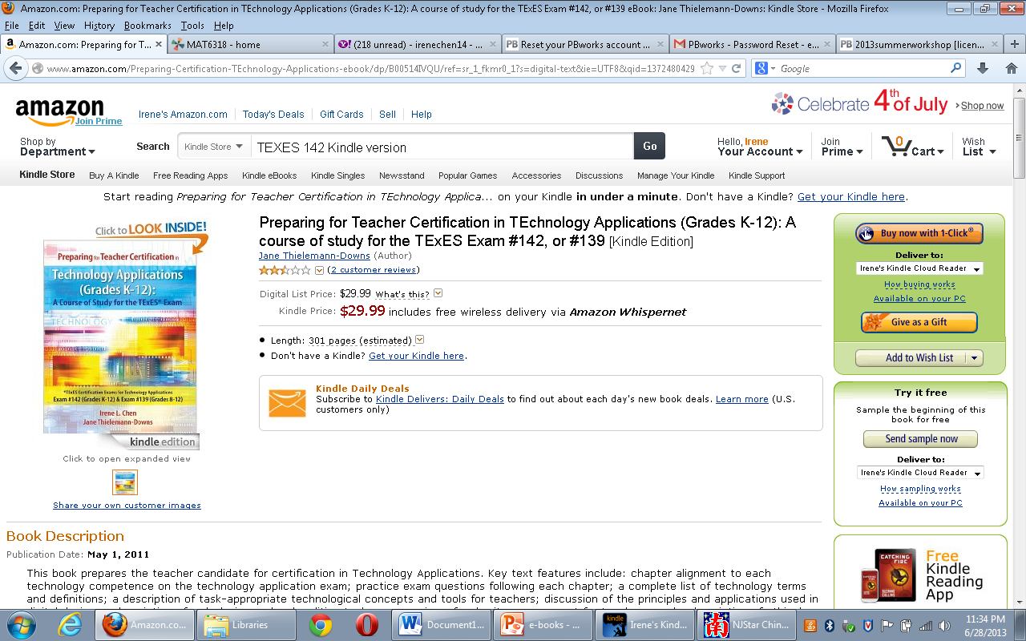

Slide 31
Review: Major Timeline of the Web
1995 Web 1.0
Read
2005 Web 2.0
Read + Write
Web 3.0
Semantic Web + Personalization
Read + Write + Execute

Slide 32
Review: The Domains of Web 2.0
Social/collaborative
User generated design
Knowledge manage

Slide 33
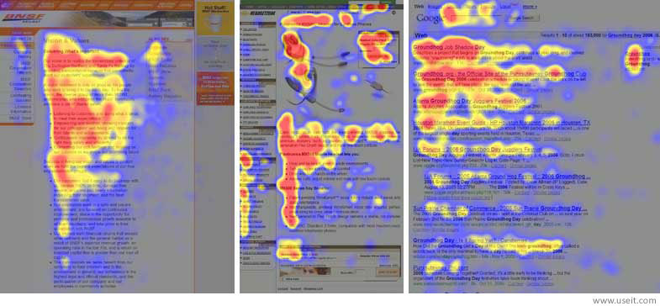
Publication -- Weblication
Eye-tracking visualizations show that users often read Web pages in an F-shaped pattern: 2 horizontal stripes followed by 1 vertical stripe.
http://www.nngroup.com/articles/f-shaped-pattern-reading-web-content/

Slide 34
Publication -- Weblication
Print design | 2-dimensional | canvas experience
Web design | N-dimensional | Scrolling experience
Access by Design e-book by Sarah Horton
http://universalusability.com/

Slide 35
Universal Design (UD)
http://projectone.cannect.org/universal-design/seven-principles.php

Slide 36
Easiest Ways to for Teachers to Create an E-book
PDFs
Self-publish
PowerPoint (see sample)
Web 2.0 sites
Other…

Slide 37
Review: Collaborative learning activities
Collaborative writing
Group projects
Joint problem solving
Debates
Study teams

Slide 38
Wiki book hosting sites
Wikispaces.com
PBWorks.com
Google Doc
…

Slide 39
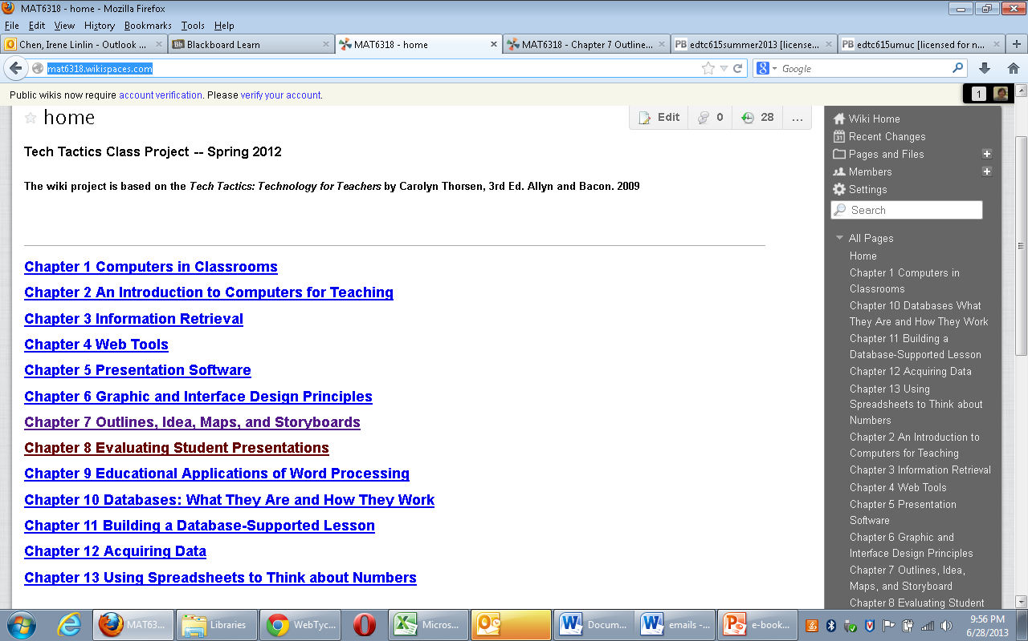
Take Wiki Book as an Example: http://mat6318.wikispaces.com/

Slide 40
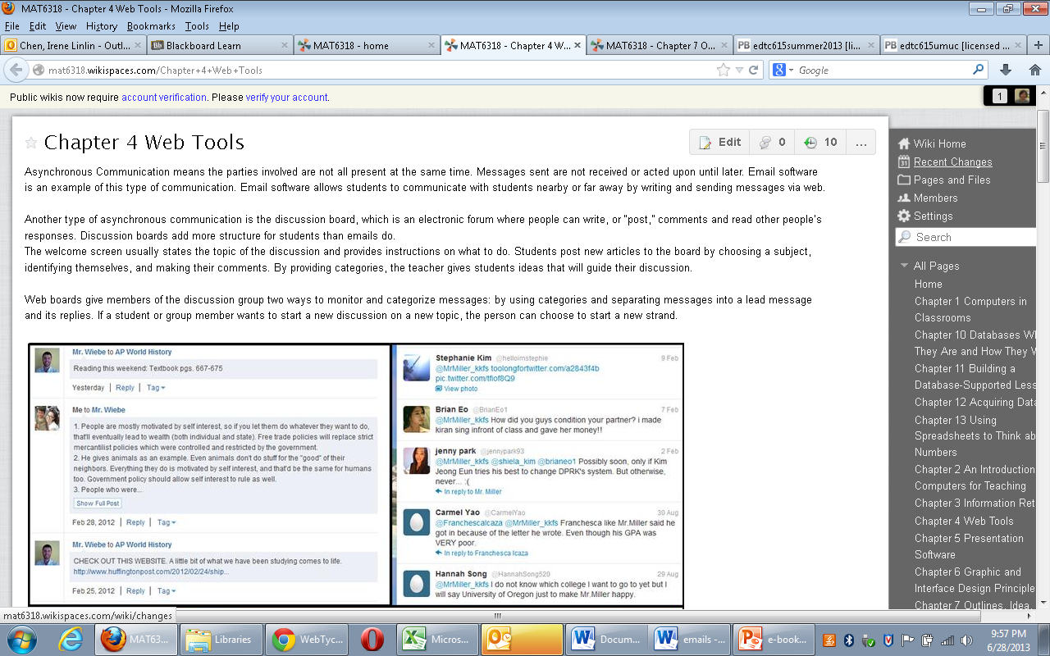
http://mat6318.wikispaces.com/ Wiki Book of a Class Textbook

Slide 41
Class Wiki
http://2013summerworkshop.pbworks.com
The biggest obstacle: page locking

Slide 42
Review: Three Learning Domains
Cognitive domain 認知領域
Affective domain 情感領域
Psycho-motor domain 技能領域

Slide 43
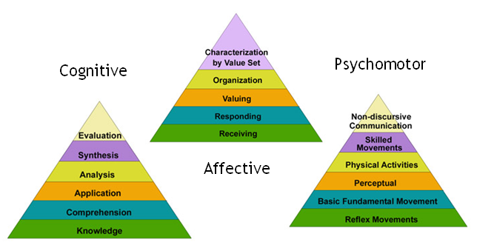
Review: Three Learning Domains

Slide 44
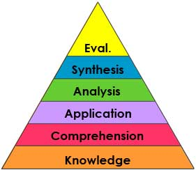
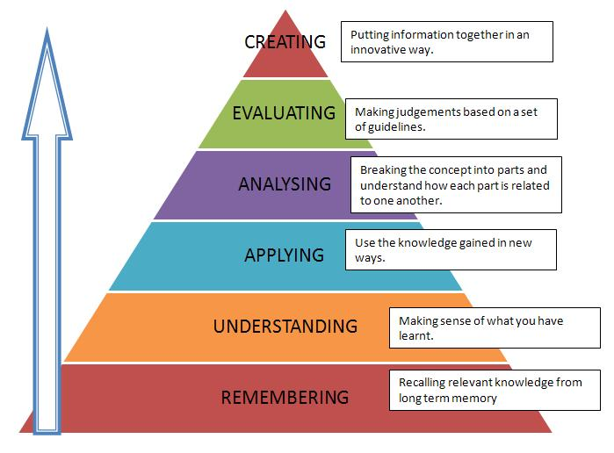
Review: Old Taxonomy and New Taxonomy
Higher Order Thinking Skills (HOTS)

Slide 45
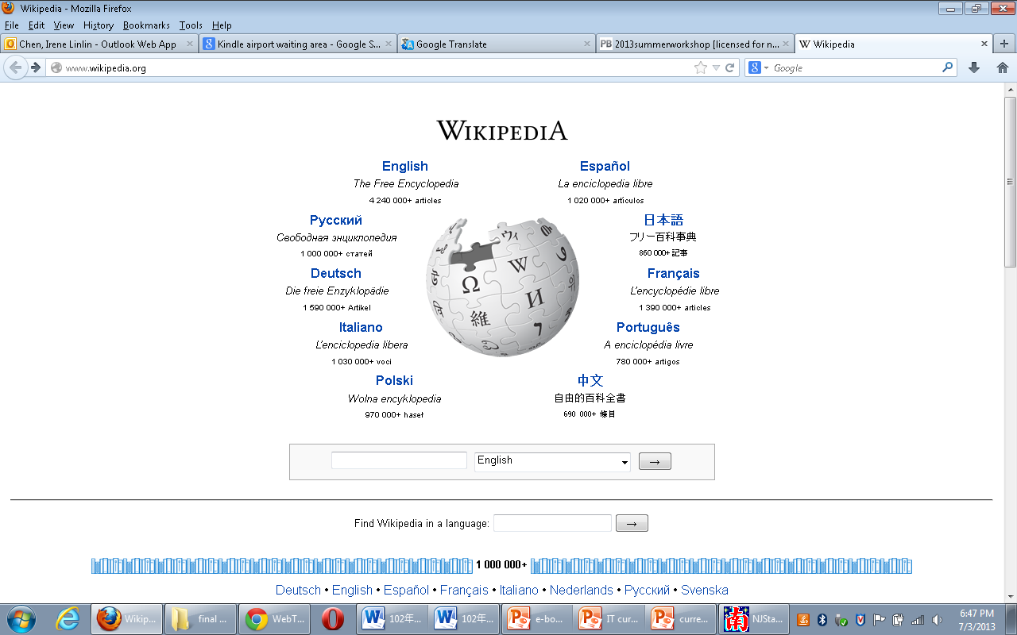
http://www.wikipedia.org/

Slide 46
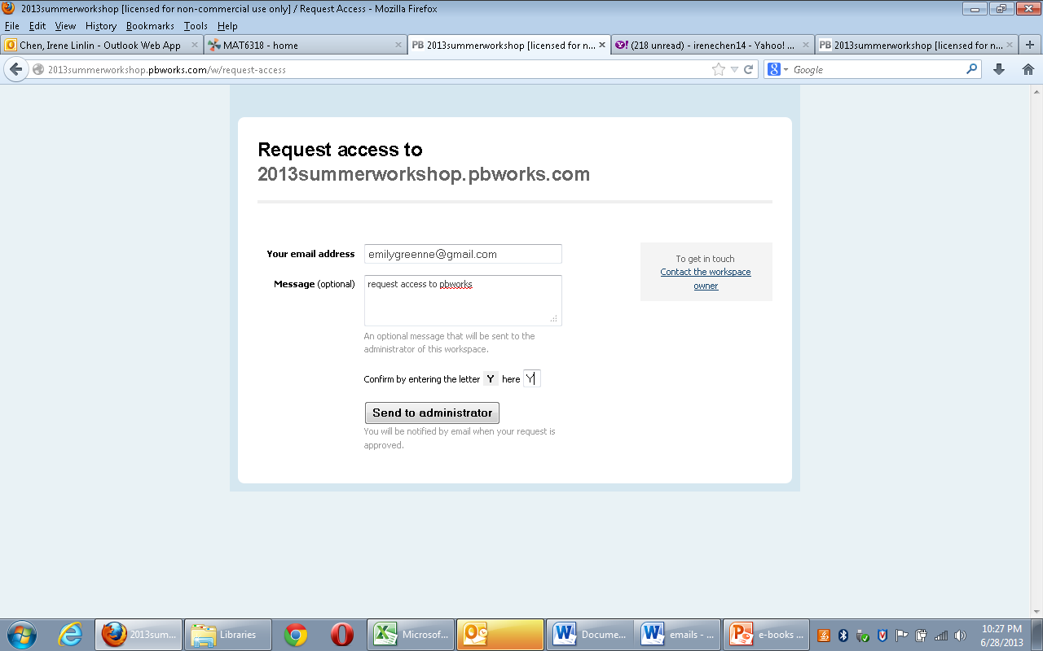

Slide 47
Resources
http://en.wikipedia.org/wiki/Electronic_page
http://www.nngroup.com/articles/f-shaped-pattern-reading-web-content/

Slide 48
Q & A
Thank you!
Contact: irenechen14@yahoo.com

