Slide 1
Dr. Irene Chen 陳琳琳
The Many Faces of Electronic Presentations
Summer 2013

Slide 2
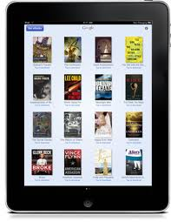
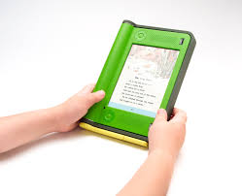
Review: An Electronic Page
A term to encompass the grouping of content between basic breaking points in presentations or documents that originate or remain as visual electronic documents.
A software file
An electronic paper
A hardware display technology

Slide 3
Review: An Electronic Page: Sizes
Sizes
Standard sized
a word processor file
desktop publishing application file
presentation software file
Dynamic size and content
HTML pages

Slide 4
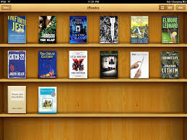
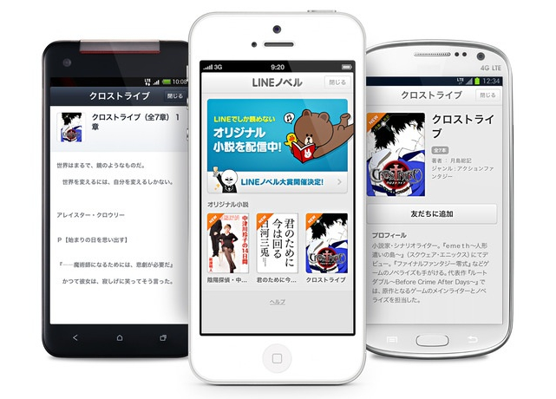
Review: E-Pages
Screens
Windows
Interfaces
Scenes
Cards
Slides

Slide 5
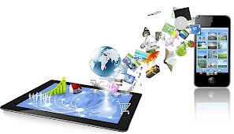
Review: Output
Display
Computer monitor
Handheld device
Printouts
Outlines
PDFs
Graphics
Videos
Web pages
CDs/DVDs

Slide 6
Two Platforms of Presentations
Chalk and talk vs Electronic Presentations
Computer-based Presentations
Web-based Presentations

Slide 7
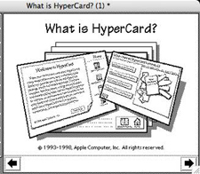
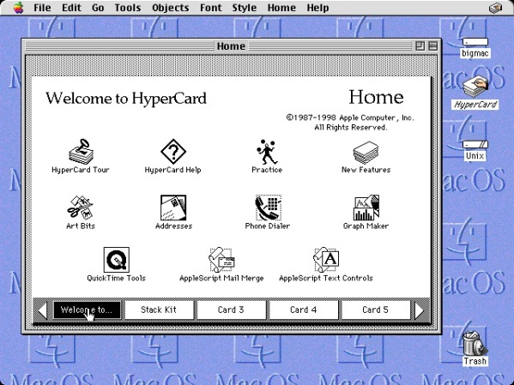
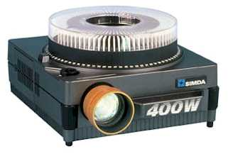
Metaphors
Cards索引卡: HyperCard, HyperStudio
Slides投影片: The "slide" analogy is a reference to the slide projector

Slide 8
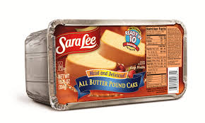
Microsoft PowerPoint
Microsoft launched PowerPoint in1990 with Windows 3.0
Predecessor:
Presenter
Persuasion
Impress
Harvard Graphics (1986)
Focal Point
Translation: Focal Point
Japanese: パワーポイント
Greek
Thai
……….
Nobody doesn’t like Sara Lee
Nobody doesn’t like ________ (Fill in the Blank)

Slide 9
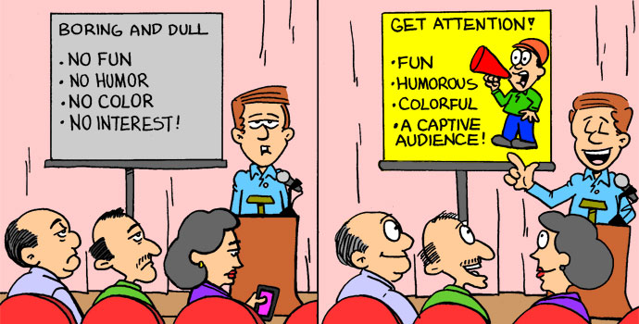
Criticism
Boredom Linear Mode of Learning
Non-linear mode of learning
Hyperlinks
Internal
External
Action buttons

Slide 10
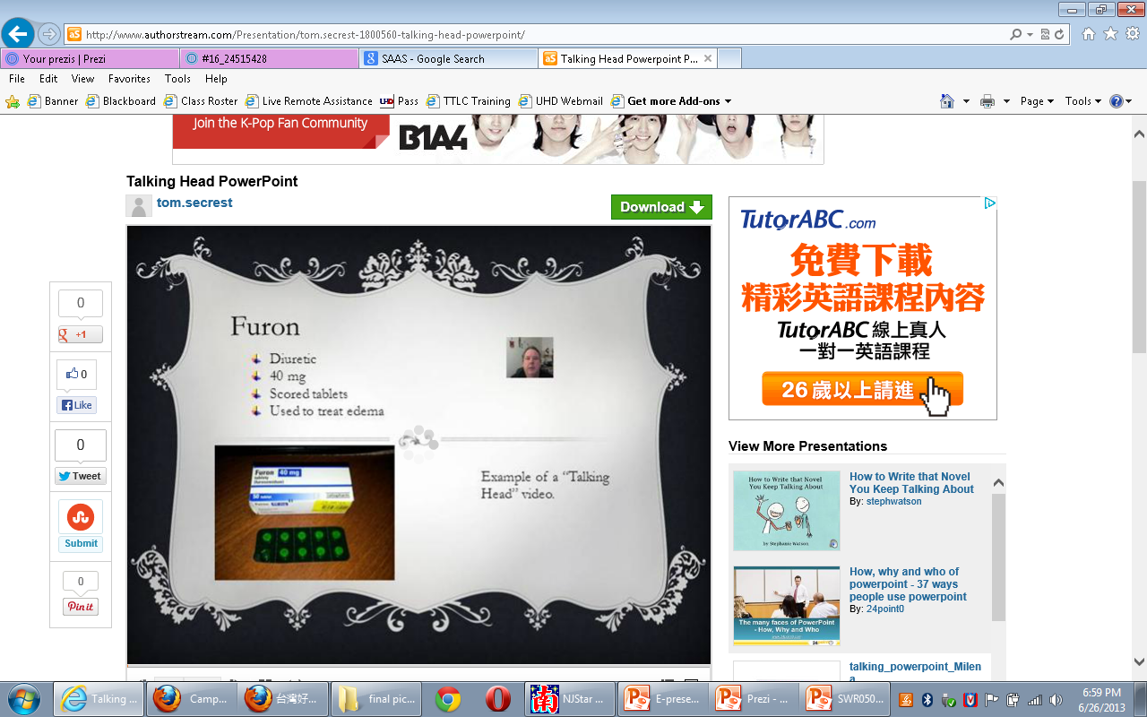
Talking head

Slide 11
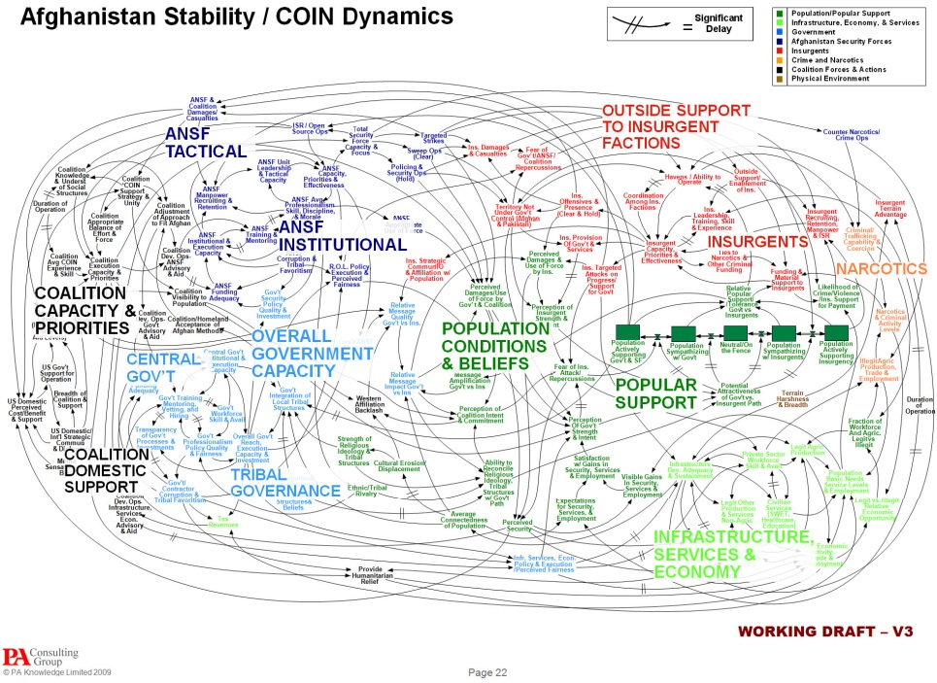
Military Excess

Slide 12
Book: How PowerPoint Makes You Stupid

Slide 13
The Many Faces of Electronic Presentations

Slide 14
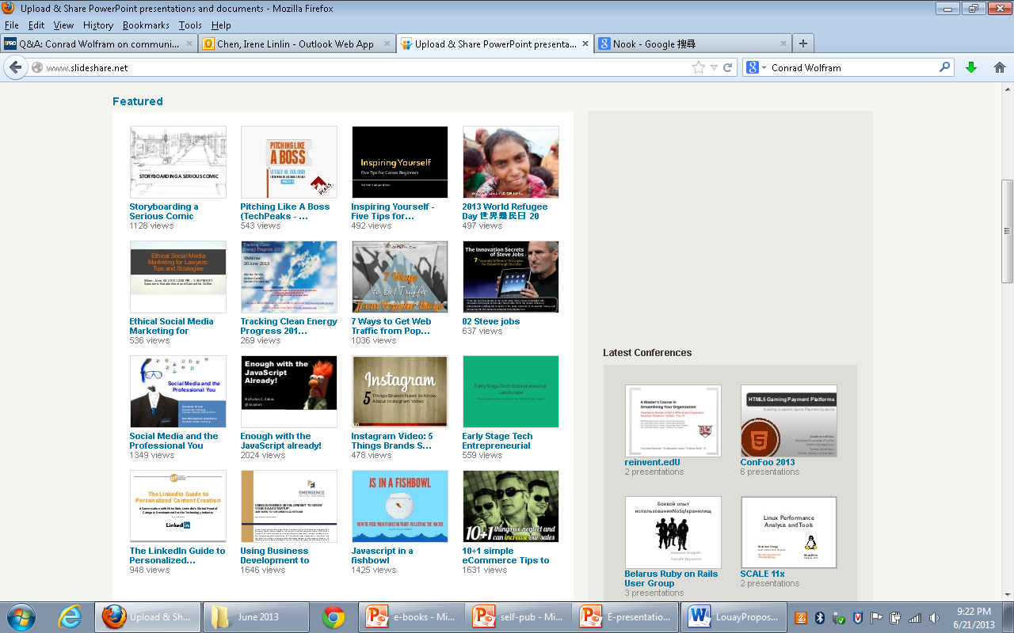
SlideShare.com

Slide 15
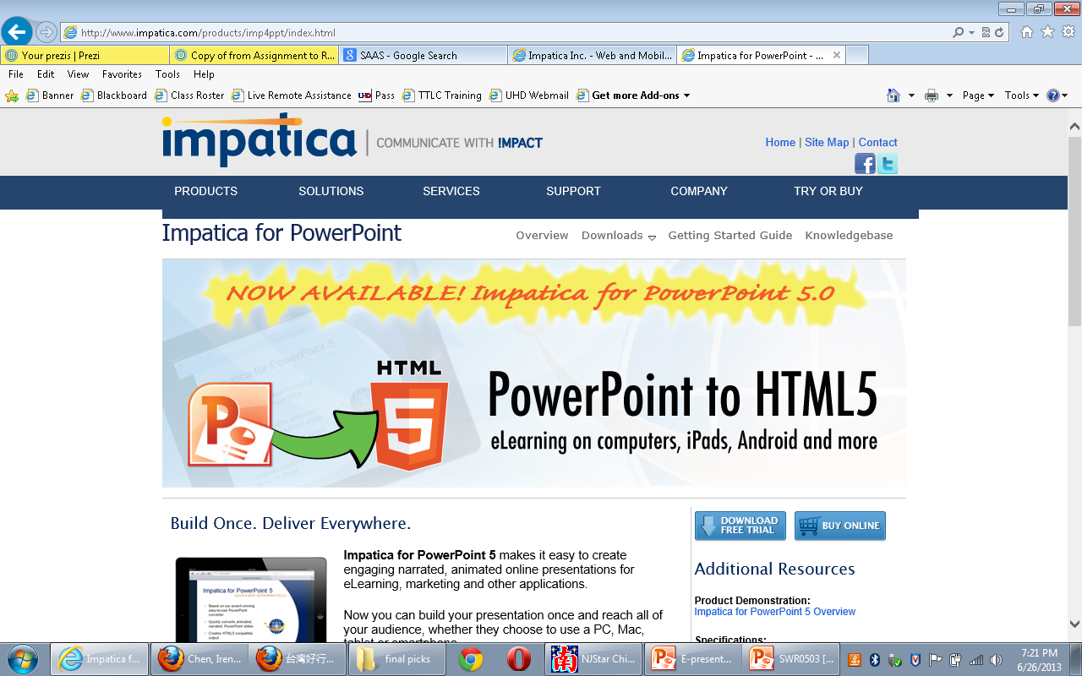
Impactica

Slide 16
Impactica
http://www.impatica.com/
Create engaging narrated, animated online presentations
Build your presentation once and reach all of your audience, whether they choose to use a PC, Mac, tablet or smartphone

Slide 17
Impactica
Impatica for PowerPoint 5 play using HTML5
When HTML5 is not available, the Impatica player displays the very same content using Adobe Flash Player instead.
Impaticize PowerPoint
Free trial

Slide 18
Web-based Applications
authorSTREAM
Brainshark
Docstoc
Google Docs
Facebook Documents
Prezi
Scribd
SlideRocket
SlideShare
wePapers
Voicethreads

Slide 19
Rich Media Content to Spice Up Your E-Presentations
Video
Audio
Hyperlinks
Interactions
Animations
Web Tours
PDF Files
Downloadable
Documents

Slide 20
See samples
Microsoft PowerPoint E-books
Microsoft Photostory

Slide 21
Prezi
SAAS “Software as a service”
On-demand software
Cloud-based
Set up account
Re-usables as templates
http://prezi.com/yod1-czcbno_/from-assignment-to-research-question/

Slide 22
Resources:
Google Images
http://www.authorstream.com/Presentation/tom.secrest-1800560-talking-head-powerpoint/

Slide 23
Q & A Thank you!
Contact: irenechen14@yahoo.com

