Slide 1
Dr. Irene Chen 陳琳琳
Major Instructional Design Models
Summer 2013

Slide 2
Timeline of Instructional Media
1950s to mid-1960s | Television | Growth of Instructional television
1950s-1990s | Computer | Computer-assisted instruction (CAI) research started in the 1950s, became popular in the 1980s a few years after computer s became available to general public.
1990s-2000s | Internet, Simulation | The internet offered opportunities to train many people long distances. Desktop simulation gave advent to levels of Interactive Multimedia Instruction (IMI).
2000s-2010s | Mobile Devices, Social Media | On-demand training moved to people's personal devices; social media allowed for collaborative learning.

Slide 3
Instructional Design Theories & Models模型
http://en.wikipedia.org/wiki/Instructional_design#ADDIE_process

Slide 4
Learning Domains 学习领域 Learning Outcomes 学习成果
Benjamin Bloom and Robert Gagnè
Cognitive Domain認知領域
Verbal information
Intellectual skills - label or classify the concepts
Intellectual skills - to apply the rules and principles
Intellectual skills - problem solving allows generating solutions or procedures
Cognitive strategies - are used for learning
Affective Domain情感領域
Attitudes - are demonstrated by preferring options
Psychomotor Domain技能領域
Motor skills - enable physical performance

Slide 5
Instructional Design Models
Rapid prototyping
Dick and Carey
Instructional Development Learning System (IDLS)
Other instructional design models
ADDIE process

Slide 6
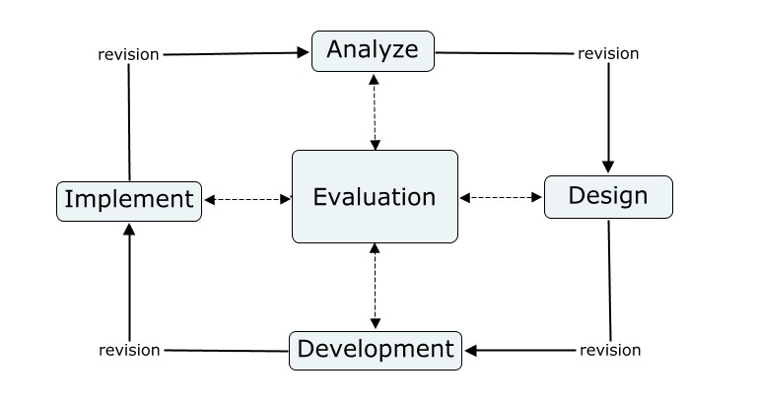
ADDIE
ADDIE (Analysis, Design, Development, Implementation, and Evaluation) Model: an instructional design model that represents a flexible guideline for constructing effective training support tools

Slide 7
ADDIE
Florida State University to explain the processes involved in the formulation of an instructional systems development (ISD) program for military interservice training
The version as we understand it today appeared in the mid-80s
Connecting all phases of the model are external and reciprocal revision opportunities
Aside from the internal Evaluation phase, revisions should and can be made throughout the entire process.
Each phase in this model is done in a linear method.

Slide 8
Rapid Prototyping
A group of techniques used to quickly fabricate a scale model of a physical part or assembly using three-dimensional CAD data.
The first techniques for rapid prototyping became available in the late 1980s and were used to produce models and prototype parts
With Rapid Prototyping the ADDIE model is not used as designed. It typically has several steps merged together to streamline the process.

Slide 9
Rapid Prototyping
Used under these constraints:
• Time • Budget • Environmental restraints
Disadvantage:
Some researchers believe that many important steps of instructional design are forfeited for a faster, cheaper model.
Many problems may be overlooked and result in endless revision.
Advantage:
The needs are clearly expressed from the beginning.
The user is able to offer immediate feedback which results in a better product.
Its non-linear approach allows for more flexibility in the instruction and can catch problems early in the development stages.
RP reduces development time and costs.

Slide 10
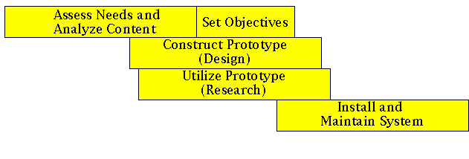
Rapid Prototyping
Rapid Prototyping should not be used by a novice, because even though it cuts out steps of ADDIE, the designer still must have knowledge of the whole process.外行勿試

Slide 11
Dick and Carey
Walter Dick
Lou Carey
James O. Carey
Walter Dick
PhD from Penn State University in Educational Psychology
Studied with Robert Gagne'
Emeritus Professor from Florida State University
Lou Carey
PhD from Florida State University
Studied with Robert Gagne' and Walter Dick
Arizona State University

Slide 12
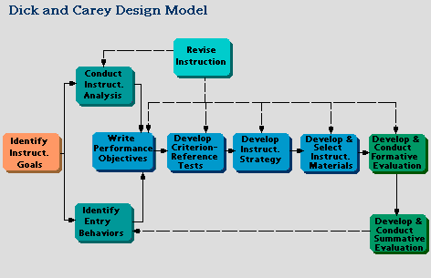
Dick and Carey
Stage 1. Instructional Goals
Stage 2. Instructional Analysis
Stage 3. Entry Behaviors and Learner Characteristics
Stage 4. Performance Objectives
Stage 5. Criterion-Referenced Test Items
Stage 6. Instructional Strategy
Stage 7. Instructional Materials
Stage 8. Formative Evaluation
Stage 9. Summative Evaluation

Slide 13
Dick and Carey
Dick and Carey (1996) pointed out the systematic characteristics of their model:
Goal-directed: all the components in the system work together toward a defined goal
Interdependencies: all the components in the system depend on each other for input and output.
Feedback mechanism: the entire system uses feedback to determine whether the goal is met.
Self-regulating: The system will be modified until the desired goal is reached.

Slide 14
Jerry Willis(2009), editor of the book, Constructivist Instructional Design (C-ID): Foundations, Models and Examples, sees current Instructional Design (ID) as moving in opposite directions.
First, there is a traditional ID that focuses on a linear method of design.
The ADDIE Model and, more specifically, the Dick and Carey Model of Instructional Systems Design(ISD) are examples.
These models are based on learning theories of the behavioral and cognitive families.
ID based on constructivist learning theory

Slide 15
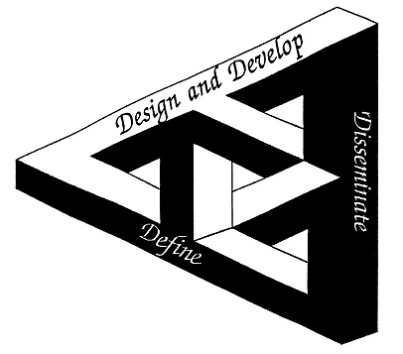
R2D2 Jerry Willis

Slide 16
The Outcome of Two Foundational Theories on Instructional Design (Willis, 2009c)
Characteristics of Objective-Rational ID Models | Characteristics of Constructivist-Interpretivist ID Models
The process is sequential and linear Planning is top-down and “systematic” Objectives guide development Experts, who have special knowledge, are critical to ID work Careful sequencing and teaching of sub skills are important The goal is delivery of preselected knowledge Summative evaluation is critical Objective data are critical | The ID process is recursive, nonlinear, and sometimes chaotic Planning is organic, developmental, reflective and collaborative Objectives emerge from design and development work General ID experts don’t exist Instruction emphasizes learning in meaningful contexts “Formative” evaluation is critical Subjective data may be the most valuable

Slide 17
R2D2 Basic Principles
Recursion – the steps taken in design need not follow a linear or waterfall sequence. The design problem should be able to be accessed from any angle at any time any number of times in any order. The situation or context determines the necessary steps, not the expert designer.
Reflection – this is a continual cycle in framing the problems that occur in the design process, improvising a solution and finally implementing the solution.
Participatory Design – all stakeholders, including students, need to be included in every aspect of the design process. The collective knowledge can be applied to produce more meaningful instruction.

Slide 18
Information sources:
http://www.wikipedia.org/
http://etec.ctlt.ubc.ca/510wiki/The_R2D2_Model_of_Instructional_Design
http://edutechwiki.unige.ch/en/

