Slide 1
Dr. Irene Chen
Current Trends in Instructional Technology
Summer 2013

Slide 2
A Few Buzz Words for Integrating Technology for Teaching & Learning
Digital Migrants vs Digital Natives:
The Youth Culture
Blended Learning & Ubiquitous Learning
Flipped classroom
Visualization
Clouds
Gamification
E-Portfolios
Assessment

Slide 3
Instructional Technology Major Timeline
1985 The future is multimedia
1995 The future is the Web
2005 The future is tablets
2015 The future is smart mobile

Slide 4
Digital Natives & Digital Immigrants
By the time you finish reading this slide,
5 million videos will have been viewed on YouTube;
1.9 million messages will have been shared on Facebook;
400,000 people will have tweeted;
15,200 people will have searched for someone on LinkedIn;
6,250 photos will have been uploaded to Flickr

Slide 5
Major Timeline of the Web
1995 Web 1.0
Read
2005 Web 2.0
Read + Write
Web 3.0
Semantic Web + Personalization
Read + Write + Execute

Slide 6
Web 1.0
Anything can link to anything

Slide 7
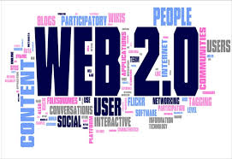
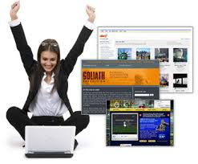
Web 2.0
User participation
Information no longer moves in one direction from top to bottom or from teacher to student.

Slide 8
The Domains of Web 2.0
Social/collaborative
User generated design
Knowledge manage
Classroom 3.0 Tutor 3.0

Slide 9
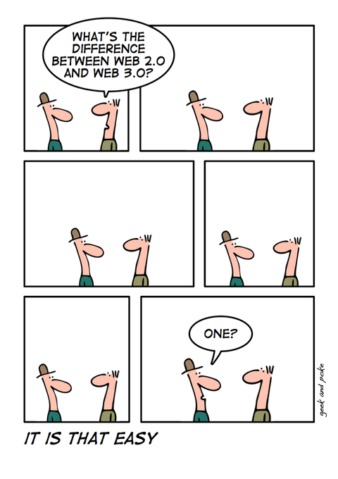
husseinahmed.com

Slide 10
Web 3.0
Existing data re-connected to other (smarter) users
A Web of openness
Semantic Web 善解人意
Example: Bing.com

Slide 11
Learn 3.0
Read, Write, Connect, Collaborate, anytime, anywhere, with anyone
It isn't enough for something to be possible. It must be easy, open and flexible.

Slide 12
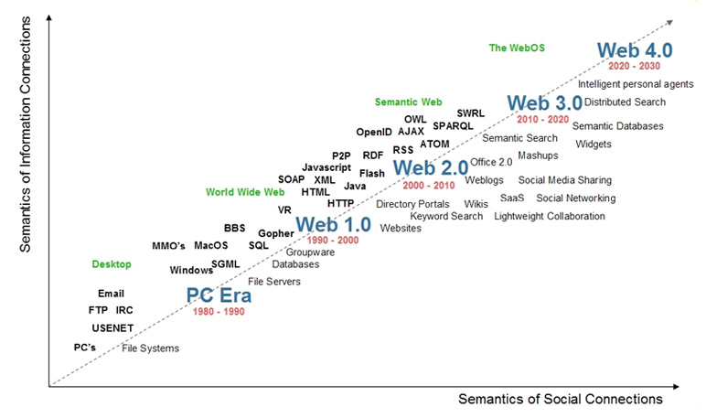
wgraziadei.home.comcast.net

Slide 13
Digital Natives & Digital Immigrants
The Web now has two digital on-ramps: Search and Social.
Both are important, and both serve to connect people with each other and with information

Slide 14
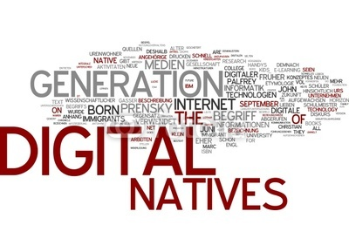
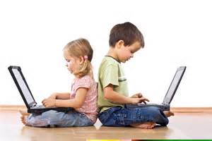
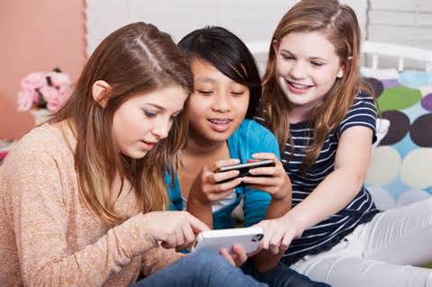

Slide 15
Popular Social Network Sites among Teenagers
Pinterest: posting pictures
Instagram: posting pictures
Skype: communication
Oovoo: communication
Google Hangouts: communication
Twitter: communication
Snapchat: sharing photos (sexting???)
Tumblr :social blogging
Meebo: consolidate Yahoo, Gmail to chat

Slide 16
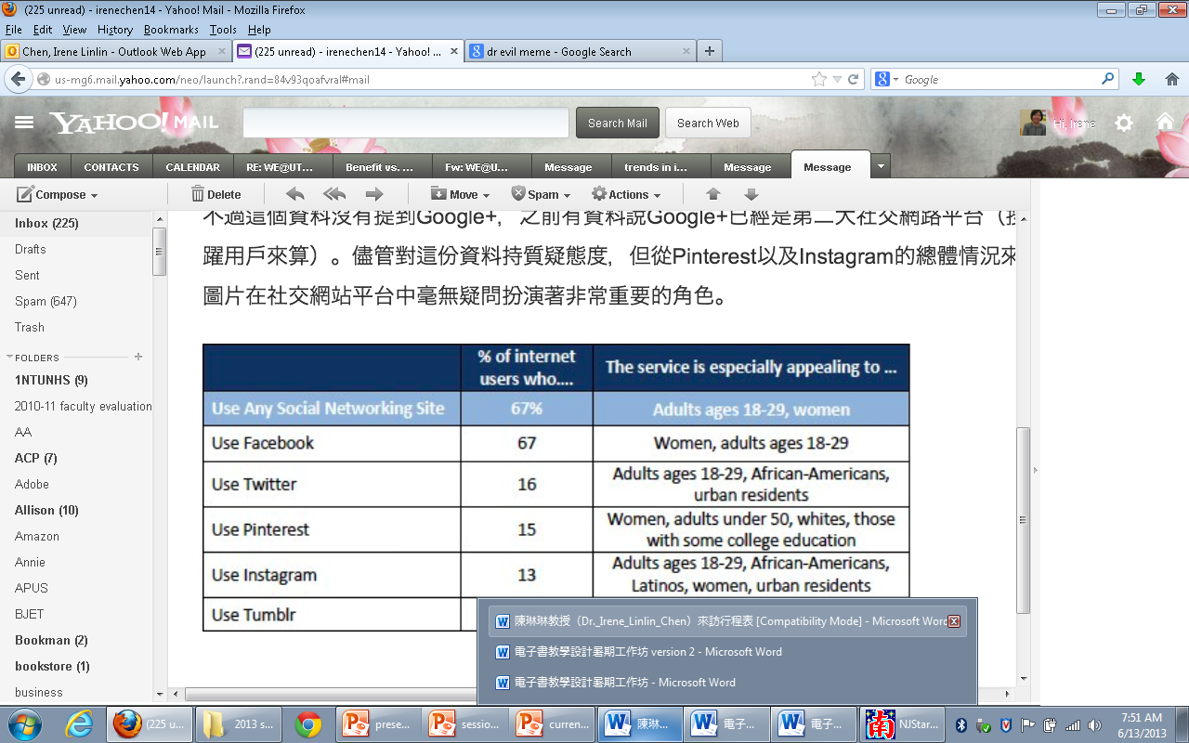

Slide 17
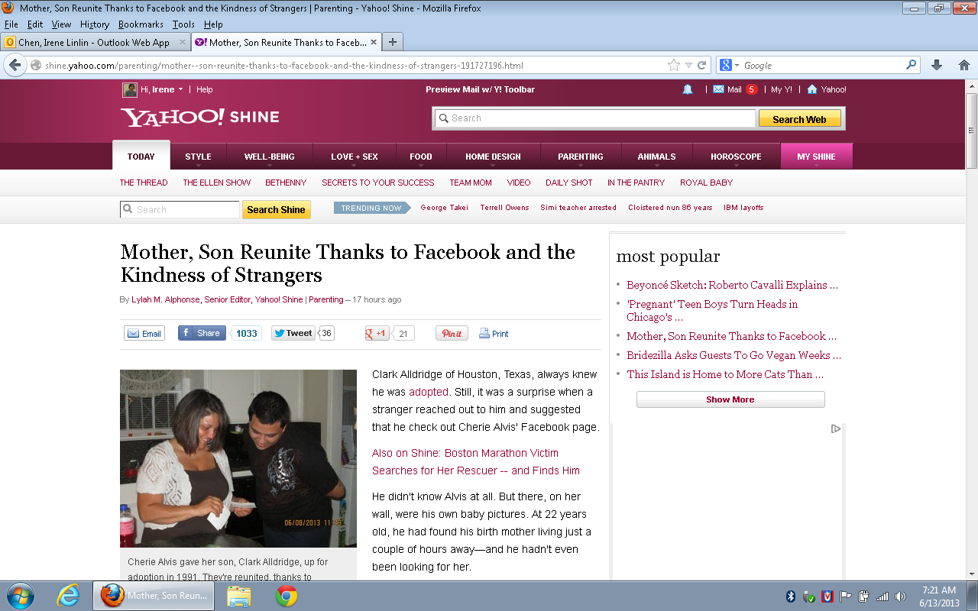

Slide 18
, 非死不可?
In a 2009 commercial survey in the UK, around 20 percent of divorce petitions included some kind of reference to Facebook.

Slide 19
"There's a lot of me out there. I have to deal with that.”
A victim compares the scar to her online reputation to a large tattoo: “Technically, it’s possible to remove it, but it’s painful and expensive. Plus, there’s no guarantee that you’ll ever remove it 100 percent.”

Slide 20
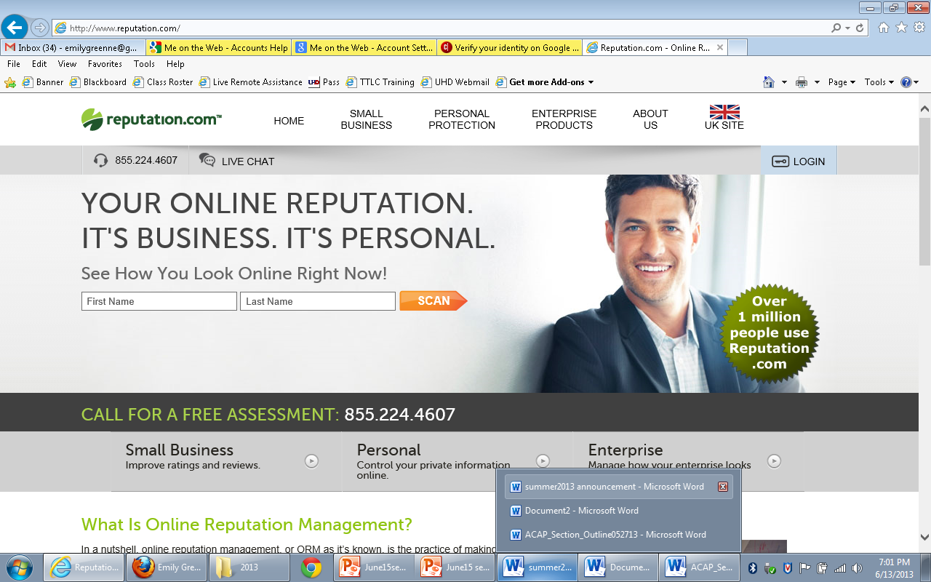
Online Reputation Management
Reputation.com
Reputationx.com
Trackur.com

Slide 21
Digital Natives vs Digital Migrants : The Youth Culture
Digital Natives
Born Digital
Generation Z
The Net Generation
The Web now has these new purposes
Productivity
Search
Social
All are important, and serve to connect people with each other and with information

Slide 22
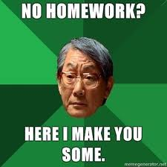
Tiger Moms & Tiger Dads

Slide 23
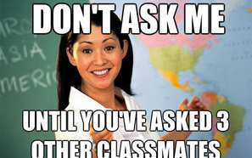
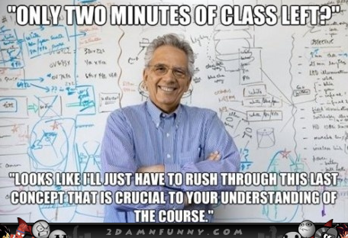
Teenagers Go to Social Networking Sites for the Following Reasons:
Talk to friends, chatting, messaging, video chats
Organization Announcements
Coordinate Volunteering
Replace emails
Create socials and events
School homework helpline
Miss class day
Questions answered
Teachers think they are cheating
Teachers search for academic dishonesty
Protests
School Meme page
Fun
Satire
Taken down by teachers due to misuses
School compliment pages
If you want to compliment somebody anonymously, tag

Slide 24
6 Types of Social Media
Social Networks - Facebook and LinkedIn.
Bookmarking Sites - Delicious and StumbleUpon.
Social News - Digg and Reddit.
Media Sharing - YouTube and Flickr.
Microblogging - Twitter.
Blog Comments and Forums - MANY.

Slide 25
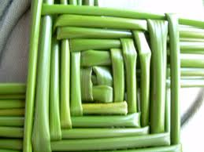
如果說一個人的社群世界是由橫軸和縱軸交織而成的虛擬空間
廣泛社群網站: Facebook
垂直社群網站: FashionGuide, BabyHome, 愛情公寓, iCook

Slide 26
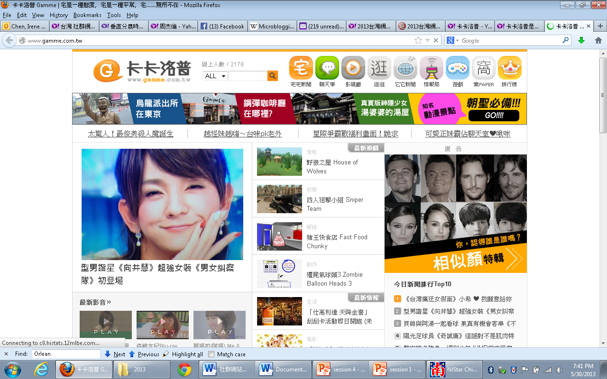
卡卡洛普 Gamme | 宅是一種態度，宅是一種平常，宅.......無所不在

Slide 27
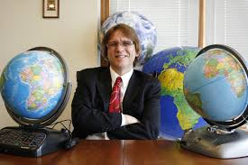
Blended Learning 混合学习
Blended Learning
Curtis Bonk
Blended learning is the combining of aspects of online and face - to - face instruction , synchronous and asynchronous modes of instructions and support
“混合学习”将在线教学和面对面教学相结合，同步与异步教学与支持相结合。

Slide 28
Blended Learning 混合学习
Rotation
Self-Blend
Enriched Virtual Model
Within each course, students divide their time between attending a brick-and-mortar campus and learning remotely using online delivery of
http://ilearnproject.com/online-learning/four-models-of-blended-learning/ content and instruction

Slide 30
Hybrid Courses混合课程
20%?
49%?+51% ?
80%?
Online Presence of All Courses
Course enrichment
Campus space
Convenience
Institute sustainability

Slide 31
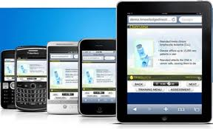
Ubiquitous Learning 泛在学习
Or uLearning
The word ubiquitous means constant, ever-present, and ongoing.
Equivalent to mobile learning
Learning can take place at any time, at any place
Education is happening all around the student but the student may not even be conscious of the learning process.
Shifts the classroom from a traditional to non-traditional context.

Slide 32
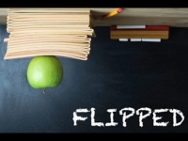
Flipped classroom反向課堂
尚在發展初期、仍處於實驗階段
Flipped帶有輕翻、翻轉之意
Flipped classroom可解釋為反向課堂，核心概念為主動學習、學生參與、混成式課程設計、以及博客(Podcasting)課堂
和 Khan Academy單純只提供線上教學影片不同
Jon Bergmann & Aaron Sams
「反向」意指打破過去學生課堂上聽講、下課後自行做練習活動之型式

Slide 33
Flipped Classroom
Students rotate on a fixed schedule between face-to-face teacher-guided projects on campus during the standard school day and online delivery of content and instruction of the subject from home after school.
The primary delivery of content and instruction is online, which differentiates a Flipped Classroom from students who are merely doing homework practice online at night.

Slide 34
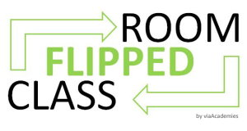
Flipped classroom反向課堂
有效結合新興科技便利性，讓學生於課堂前利用電腦、平版電腦、智慧型手機等載具，瀏覽教師自行錄製或指定現有且與課程內容相關的多個短篇幅線上影片。影片中可適切加入謎題以即時幫助學生自我檢測吸收度，且若有不解之處，也可再次觀看影片重複學習
http://www.elq.org.tw/notes_detail.php?info3_id=55

Slide 35
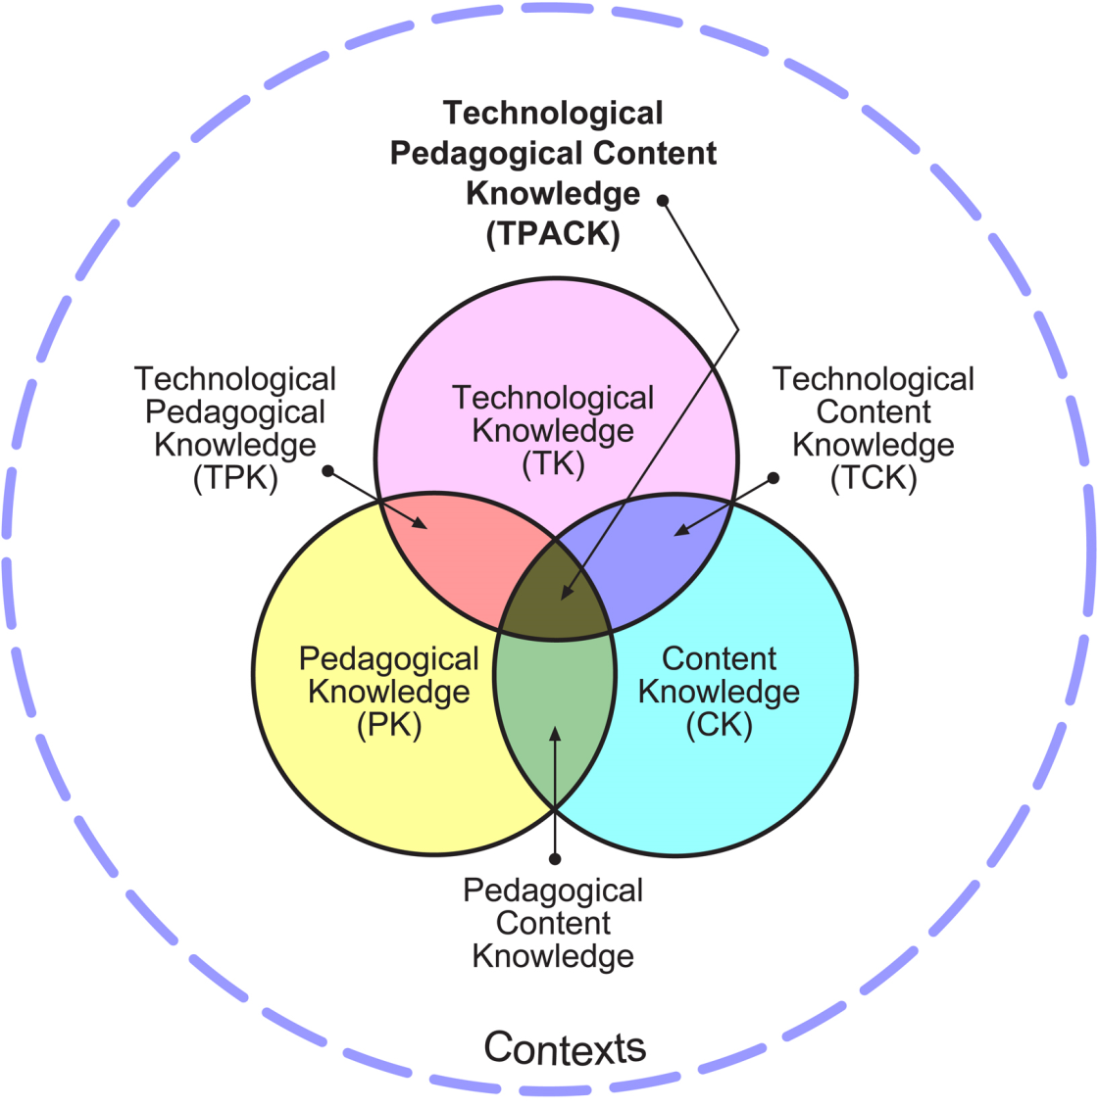
TPACK

Slide 36
Mishra & Koehler
Mishra & Koehler (2006). Technological pedagogical content knowledge: A framework for teacher knowledge. Teachers College Record, 108(6), 1017-1054
Pedagogical Content Knowledge (PCK)
Technological Content Knowledge (TCK)
Technological Pedagogical Knowledge (TPK)
The intersection of all three circles, Technological Pedagogical Content Knowledge (TPACK)

Slide 37
Origin of TPACK
A framework that identifies the knowledge teachers need to teach effectively with technology.
The TPACK framework extends Shulman’s idea of Pedagogical Content Knowledge.

Slide 38
TPACK
Effective technology integration for pedagogy around specific subject matter requires developing sensitivity to the dynamic, transactional relationship between these components of knowledge situated in unique contexts.
Individual teachers, grade-level, school-specific factors, demographics, culture, and other factors ensure that every situation is unique, and no single combination of content, technology, and pedagogy will apply for every teacher, every course, or every view of teaching.

Slide 39
Clouds雲端: Computer-based vs Web-based
Distributed computing over a network
Application service provisioning that run client servers
Sharing of resources to achieve coherence and economies of scale similar to a utility (like the electricity grid) over a network
Webication

Slide 40
Clouds雲端: Computer-based vs Web-based
On-demand computing and storage.
A familiar development experience with on-demand scalability.
Online services for anywhere, anytime access to powerful web-based tools.

Slide 41
Clouds and Higher Education
Reduce and Rationalize IT Capital Expense
Support the Global Campus
Make IT Greener
Deliver Education as a Service

Slide 42
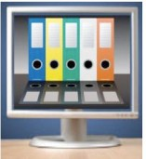
Visualization
Learning styles
Neil Fleming's VAK/VARK model
One of the most common and widely-used categorizations of the various types of learning styles is Fleming's VARK model:
visual learners
auditory learners
reading-writing preference learners
kinesthetic learners or tactile learners

Slide 43
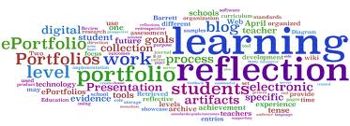
E-Portfolios
Types
Showcase
Progress
Assessment
Reflection
Purpose:
Accreditation
Record keeping
Assessment
Platforms
Individual Web-sites
CDs, DVDs
Institute Web-sties

Slide 44
Q & A
Thank You!
cheni@uhd.edu

