Slide 1

Things That Grow
Illustrated by Renee Trachtenberg
1997 Landoll, Inc.
Cleo Mohansingh
PED 3301 Summer 2013
Dr. Irene Linlin Chen

Slide 2
TEKS/Objectives
K-3. 9. Reading/comprehension. The student uses a variety of strategies to comprehend selections read aloud and selections read independently. The student is expected to:
  (B) establish purposes for reading and listening such as to be informed, to follow directions, and to be entertained (K-3)
1-3.15. Writing/penmanship/punctuation. The student composes original texts using the conventions of written language such as capitalization and penmanship to communicate clearly. The student is expected to:
  (B) use capitalization and punctuation such as commas in a series, apostrophies in contractions such as can’t and possessives such as Robins, quotation marks, proper pronouns, and abbreviations with increasing accuracy (3)
The student will be able to identify things that grow.

Slide 3
Materials
Book: Things That Grow
  ISBN# 1-56987-724-6
PowerPoint Access
PowerPoint: Things That Grow
Notebook and Pencil

Slide 4
Things That Grow
Ms. Mohansingh 2013

Slide 5
Things That Grow
Read the Book aloud-Things That Grow
Answer questions at the end of PowerPoint
Write the answers in your notebook
Watch video about growing
Write a paragraph about things that grow.

Slide 6


Things That Grow

Slide 7
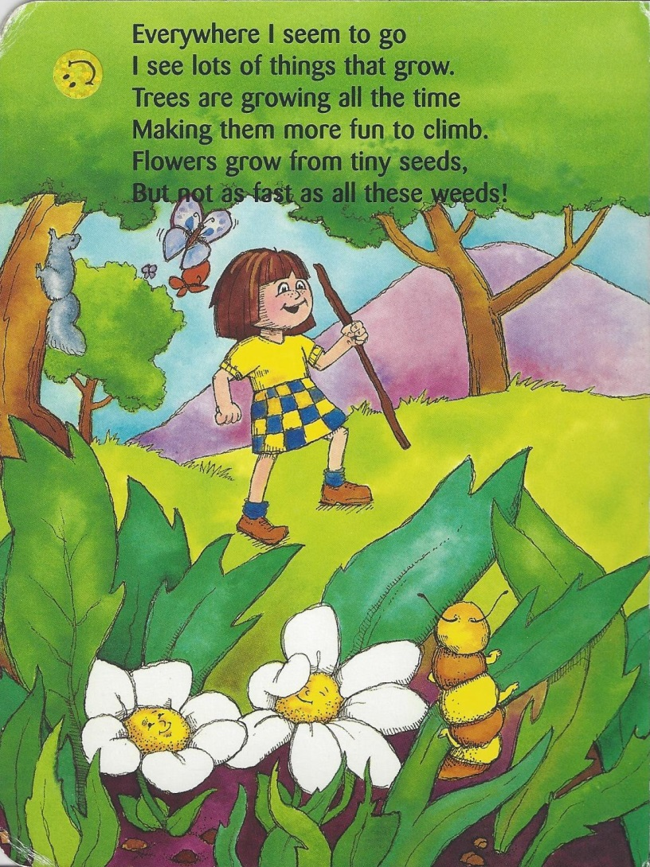
Things That Grow

Slide 8
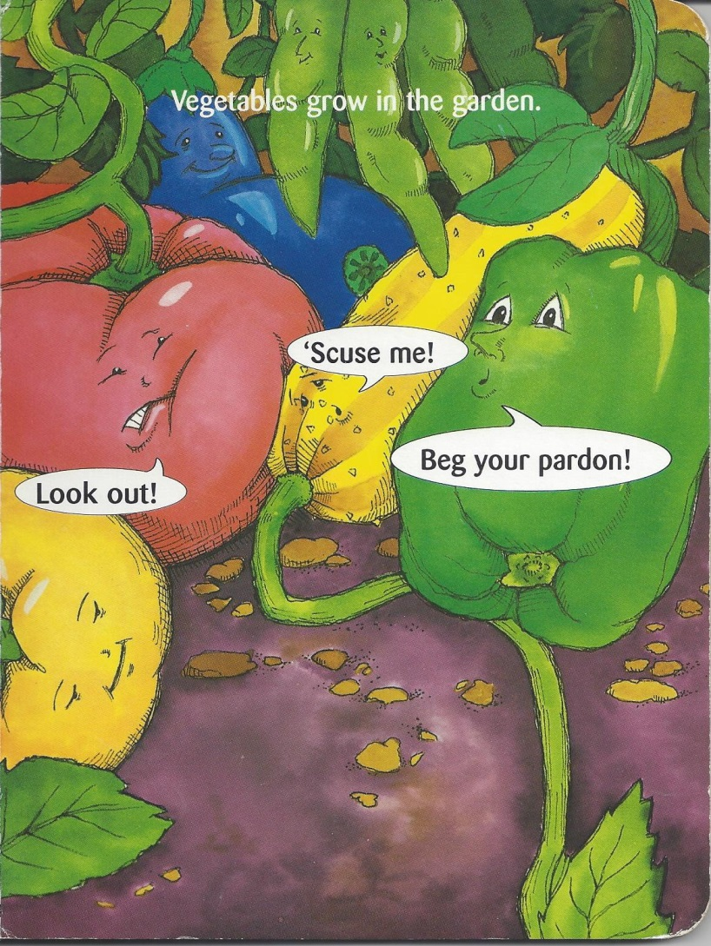
Things That Grow

Slide 9

Things That Grow

Slide 10
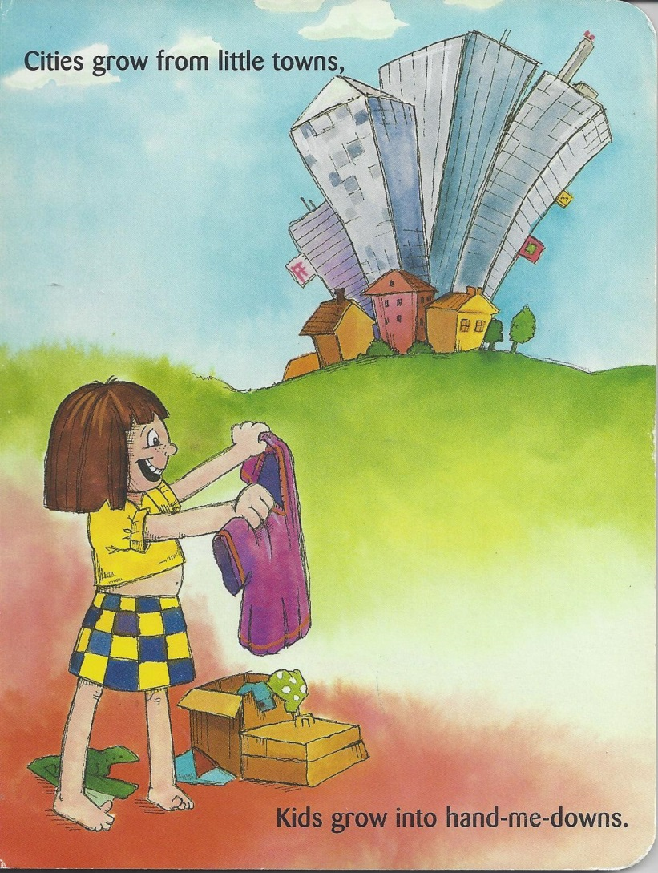
Things That Grow

Slide 11
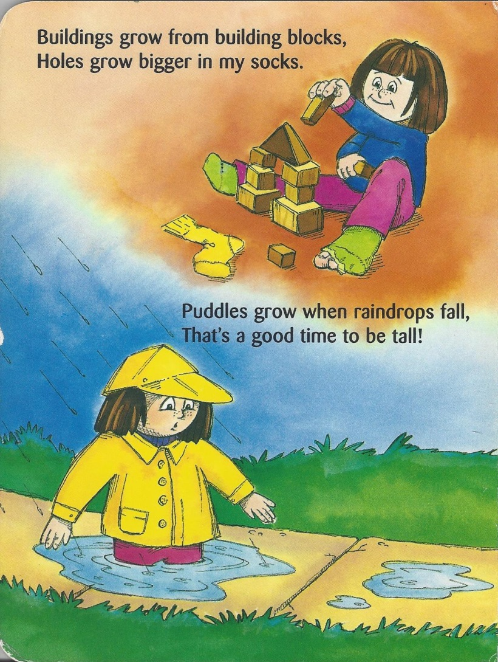
Things That Grow

Slide 12

Things That Grow

Slide 13
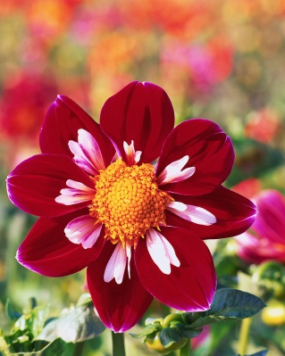
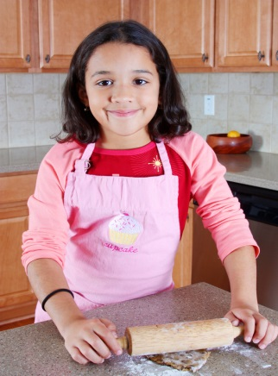
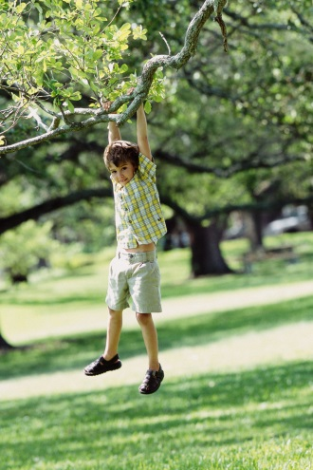
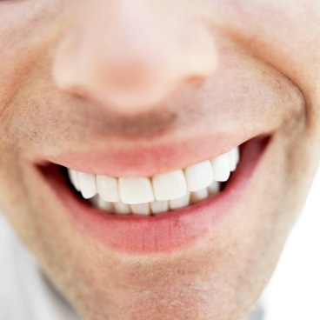
Things That Grow
Did the little girl see lots of things that grow?
  Yes
Name me some things that grow?

Slide 14
Things That Grow
Where do vegetables grow?
  In the garden
    Fantastic!
What grew on grandpa’s chin?
  Whiskers
    Awesome!
What grows when raindrops fall?
  Puddles
    Good!

Slide 15
Things That Grow
YOU HAVE DONE A GREAT JOB!
http://youtu.be/CSg3gsuLm3o

