Slide 1
Dr. Irene Chen 陳琳琳
Academe World:
Publish or Perish: Peer-reviewed & Self-Publishing
Summer 2013

Slide 2
Rank & Tenure Review in the US: A General Overview
Teaching
Student Course Opinion Survey (online, paper-based using scantron 答题卡)
High Impact Educational Practices
AACU (Association of American Colleges & Universities)
Service
International, national, state, & local levels
Scholarly/Creative Work
Peer-reviewed or referees
International, national, state, & local levels

Slide 3
Service
Department level
Committees
Tutors
Volunteer
College level
University level
Chairing
Community:
Workshops
Exhibits
Judges (professional)
Professional level
Review board
Organization officers

Slide 4
Publication: Various Types of Review
Anonymous peer review (also “blind review”)
In "double-blind" review
Conflict of interest
Open peer review
Post-publication reviews

Slide 5
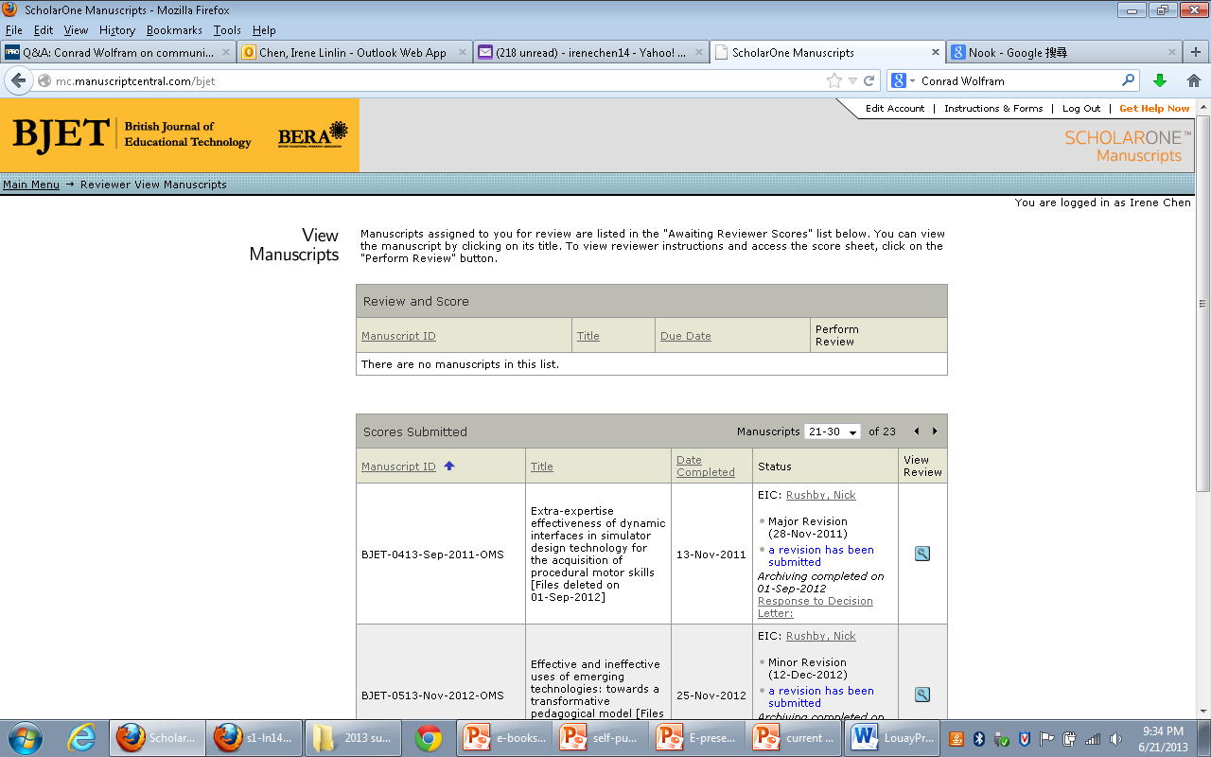

Slide 6
Types of academic publications
Books
Textbooks
Journal articles
Online journals
Book chapters
Software
Web-sites
Published curriculum design
Study guides
State publications

Slide 7
Self-Publishing
Self-publishing companies
Lulu
CreateSpace
Lightning Source
Self-publishing companies are only the same in the fact that they all use almost the exact same technologies to print books.
Each company has a unique approach to the market, and a distinct personality

Slide 8
A Few Types of Self-Publishing
Print on demand:
需要多少發行多少，不必先做出具體的產品，只需等待訂戶的訂購，依數量發行
E-books:
需要多少發行多少，不必先做出具體的產品，只需等待訂戶的訂購，依數量發行
Vanity publishing

Slide 9
Self-Publishing Business Model
Self Publishing Contract
Retail Price
Author Book Costs
Creative Control
Total Cost of Self Publishing
Print on Demand
Distribution through Amazon.com and other online and brick-and-mortar retailers
Marketing to target readers

Slide 10
Academic Author Mill
Producing large numbers of small-run books by different authors
“diploma mill”, “puppy mill”
E.g. PublishAmerica and VDM Publishing
Vanity publisher
No editorial screening

Slide 11
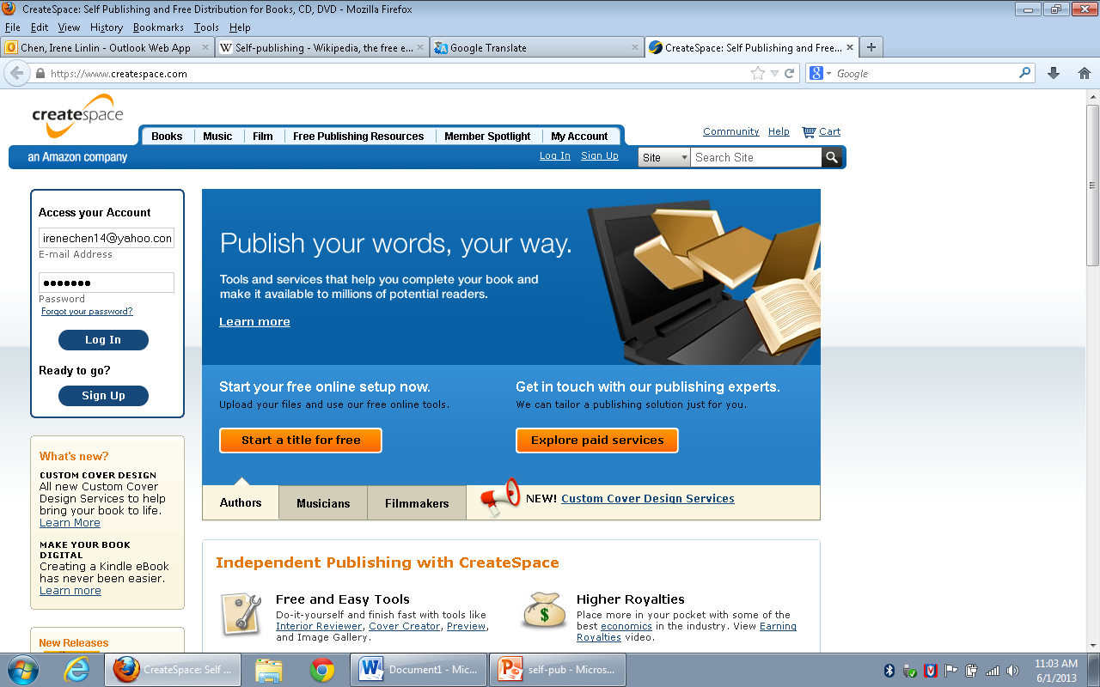
Irene’s Book on CreateSpace

Slide 12
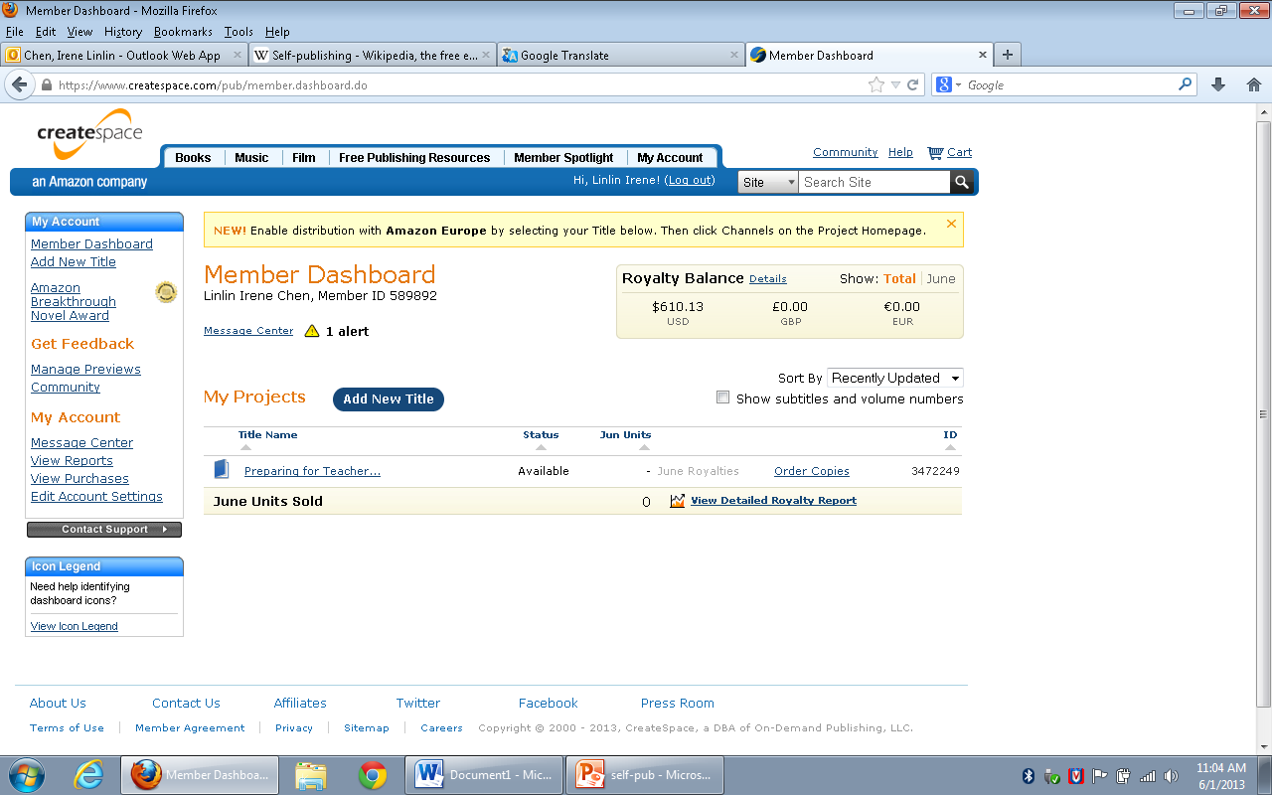
CreateSpace Author Dashboard

Slide 13
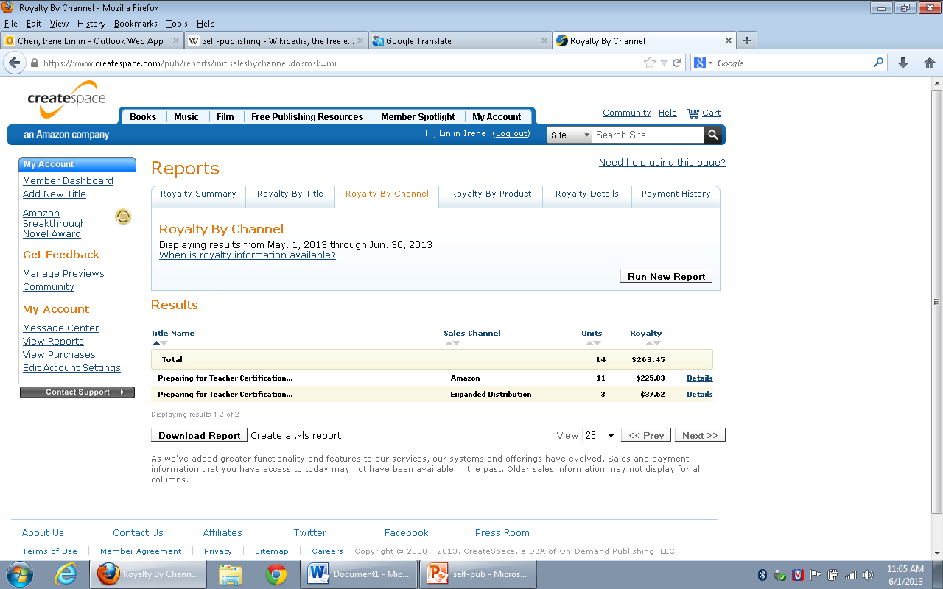
CreatSpace Loyalty Report

Slide 14
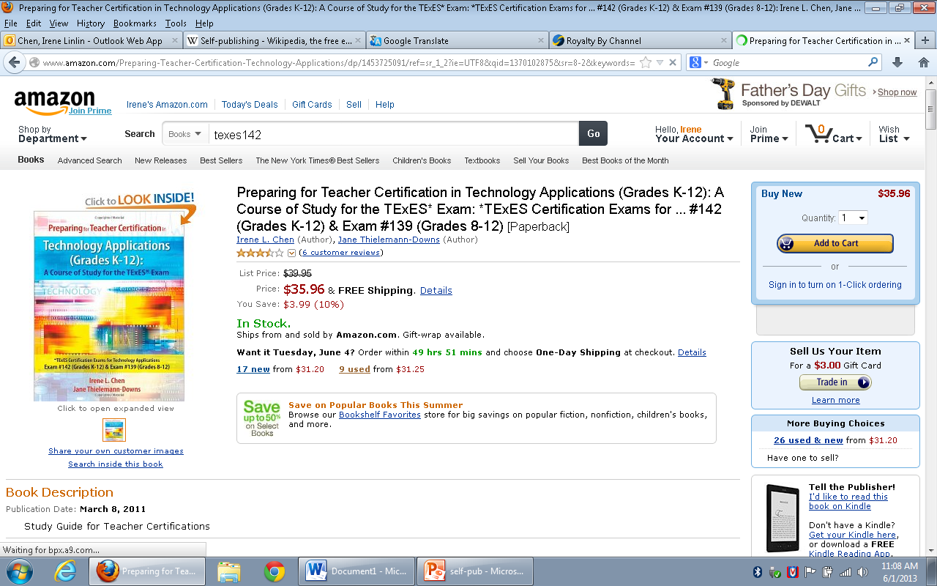
Books are sold through Amazon.com

Slide 15
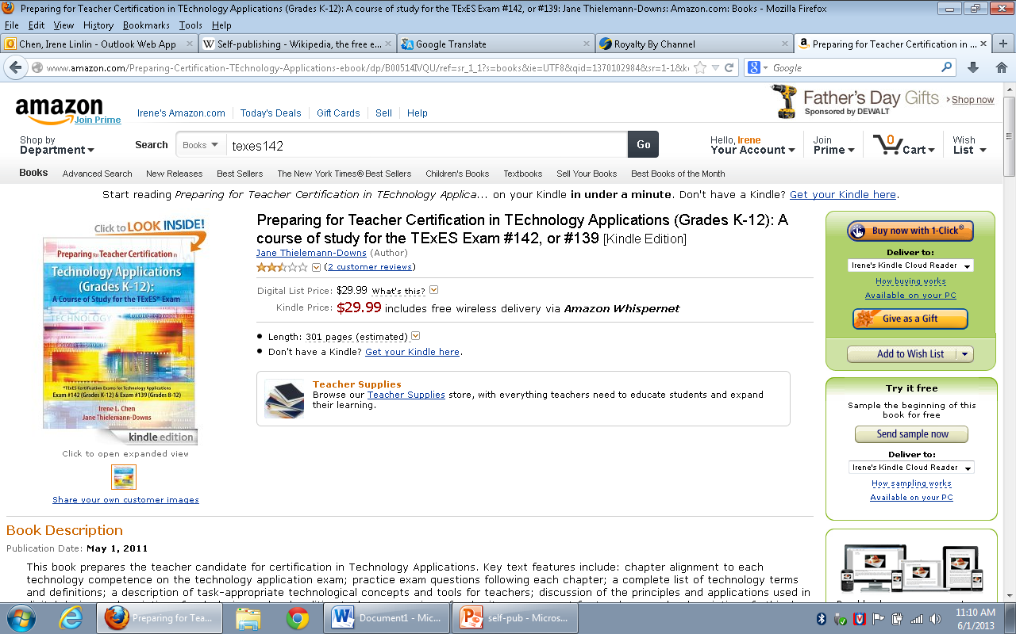
Kindle version sold through Amazon

Slide 16
Take the Consequences of Self-Publishing
Academic value?
Use your real name??
網路酸民 or網路暴民 Mob?
Consumer responses quickly spiral into name-calling and curse-word-filled rants, resulting in the equivalent of an online riot.
cursing
screaming
personal attacks

Slide 17
Q & A Thank you!
Contact: irenechen14@yahoo.com

